Slide 1
LISE ARIS 3D-Envelope: Panel Development
Alexandra Tarasova
New Isotope Research Group
Facility for Rare Isotope Beams, Michigan State University, East Lansing, MI 48824 USA
05/02/25

Slide 2
Panel Optimization
Optimized design with additional features
Previous design

Slide 3
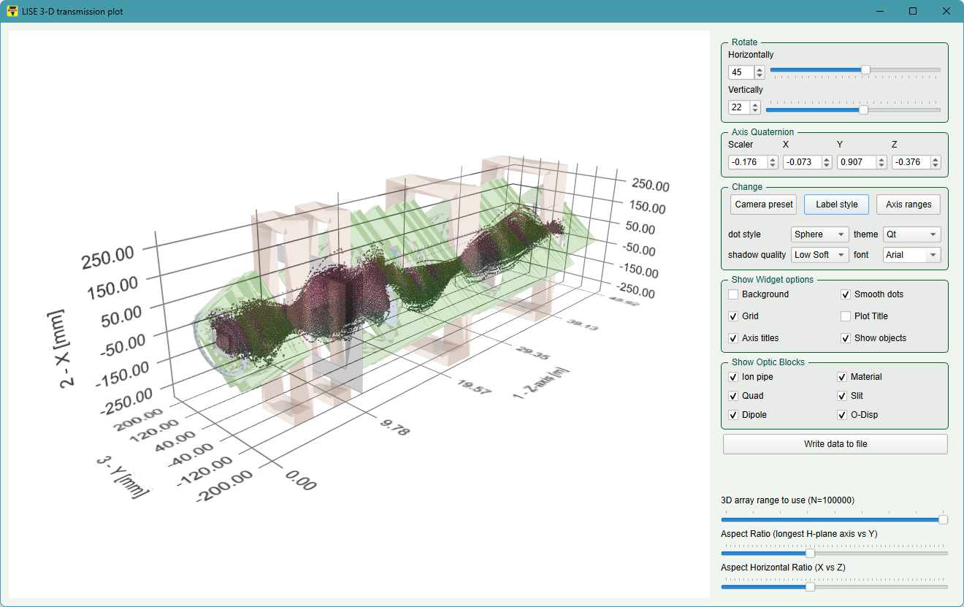
New Features
Panning of the graph using the left mouse button
Value input to adjust the angle of the graph, as well as arrows to increment.
Axis Quaternion input boxes implemented to specify 3D rotation using quaternions.
Angle of the graph updates the panel values and sliders in real time.
Synchronization of manual rotation controls and quaternion-based camera orientation.

Slide 4
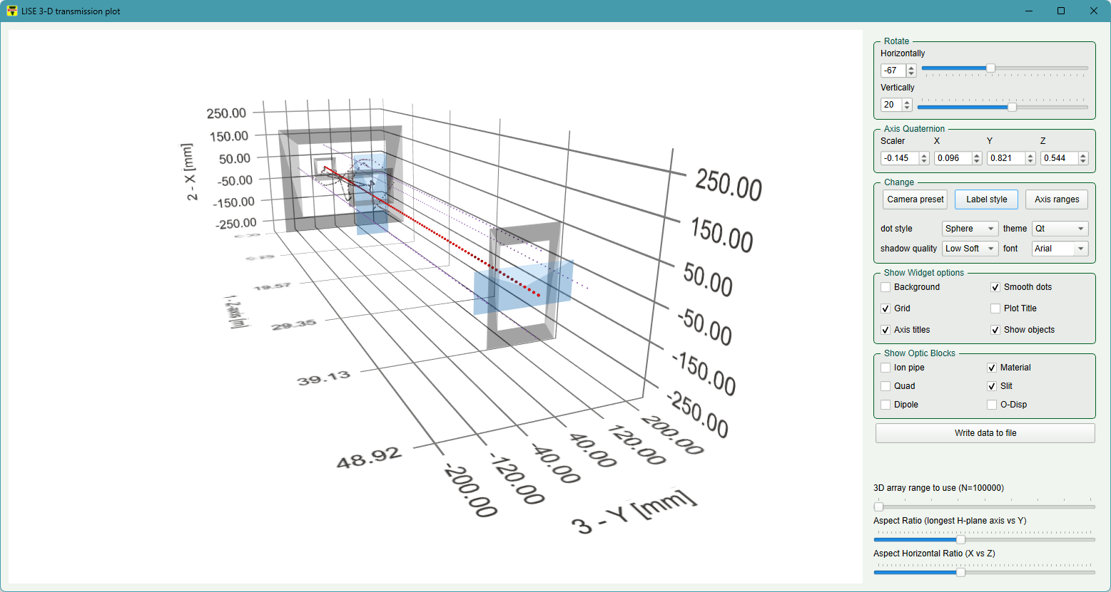
Plotting selected optic blocks

Slide 5
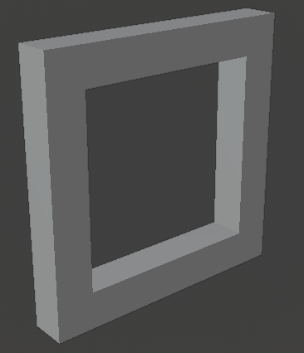
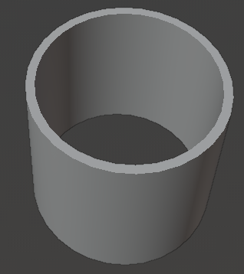
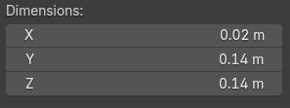
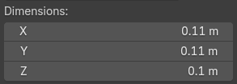
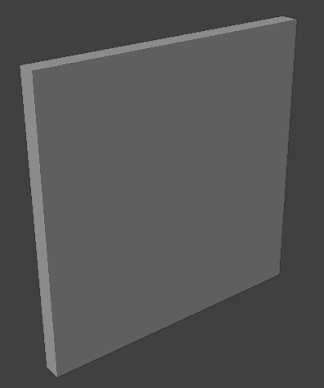
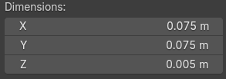
3D Separator Blocks Update (1)
Slit
Ion pipe
X
NEW
X – length : 0.2 m,
Y & Z Inner diameter 0.1 m
Y & Z Outer diameter 0.11 m
NEW
Y
Length (thick) X = 0.02 m
Inner size Y & Z = 0.10 m
Outer size Y & Z = 0.14 m
Y
Z
Z
Old
X
Old
Material
NEW
X length : 0.01 m,
Y size: 0.1 m
Z size : 0.1 m
Y
Z
X is always the central axis for ALL blocks
Old
X

Slide 6
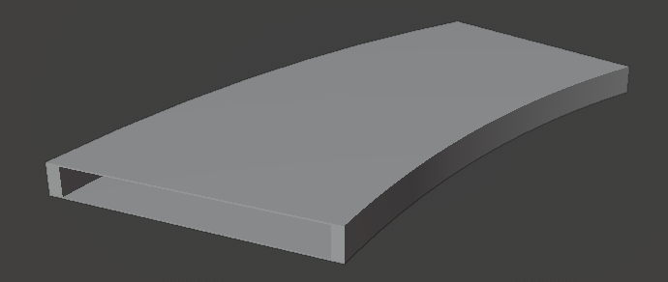
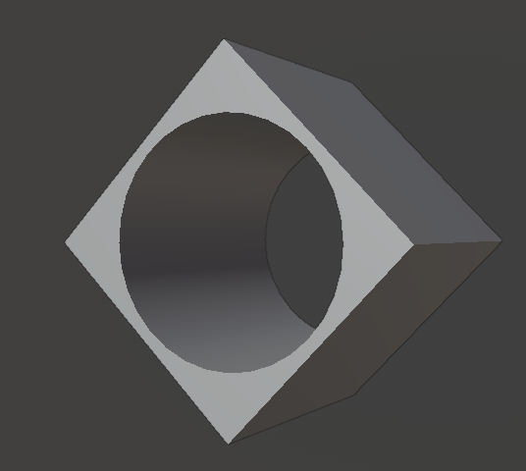
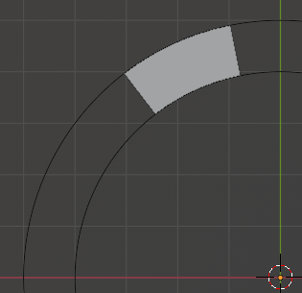
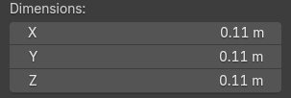
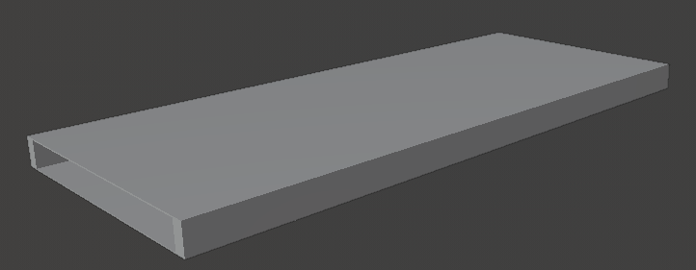
3D Separator Blocks Update (2)
Dipole
Quadrupole
NEW
X length : 0.1 m,
Y-Z inner radius : 0.05 m
Y
X
Z
Old
Inner radius 50mm
500 mm
Rmax 5000mm
Rmin 4000mm
30°
X is always the central axis for ALL blocks
100mm
110mm

Slide 7
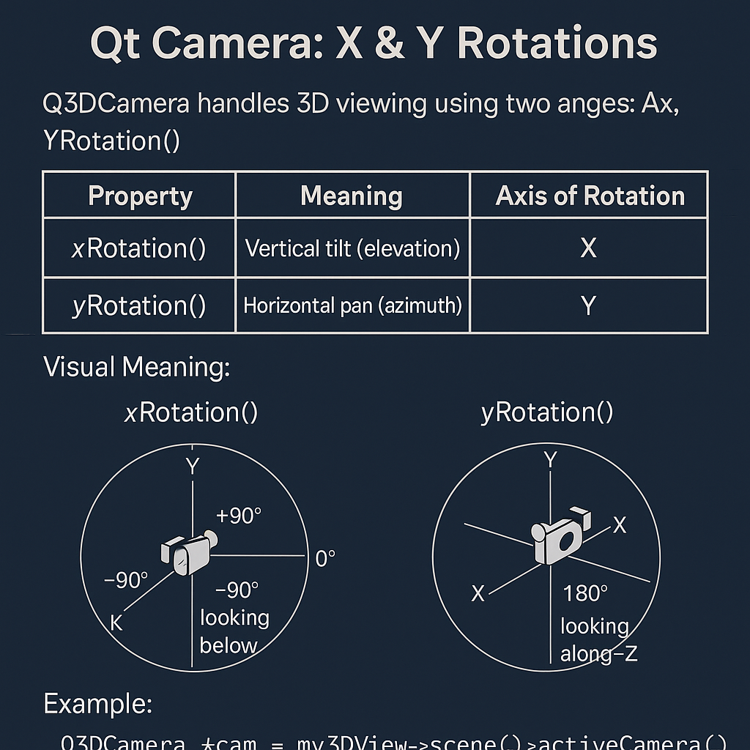
Qt Quaternion & Camera
How to synchronize
them in code?

Slide 8
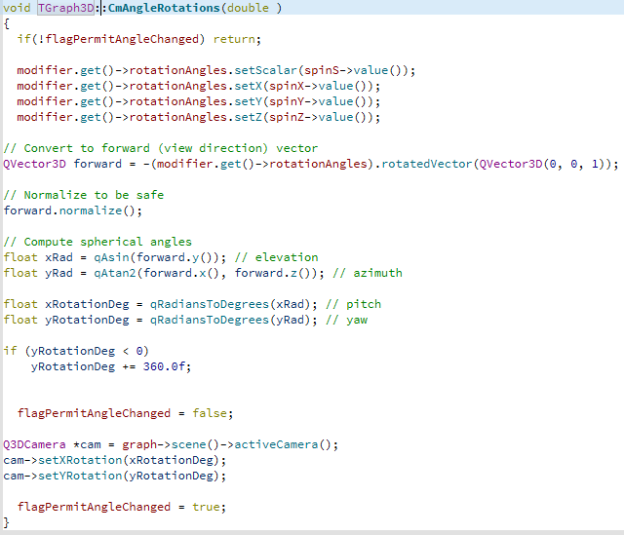

Qt Quaternion & Camera: synchronization (1)
Quaternion
Implementation of special variable :
flagPermitAngleChanged

Slide 9
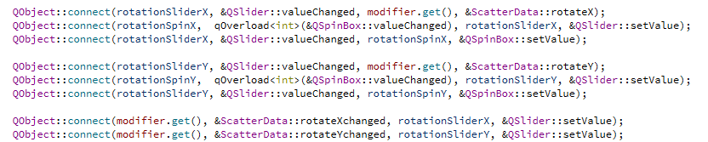
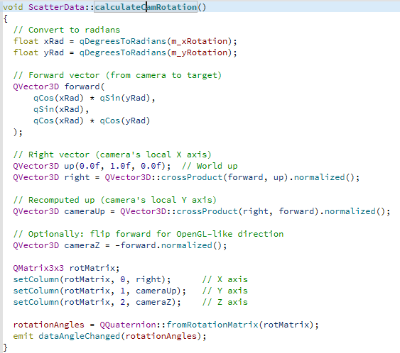
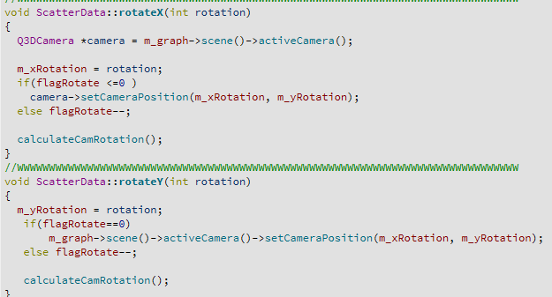
Qt Quaternion & Camera: synchronization (2)
Camera
SpinBox & Slider
Rotated by clicking mouse right button of image:
Implementation of special variable : flagRotate

Slide 10
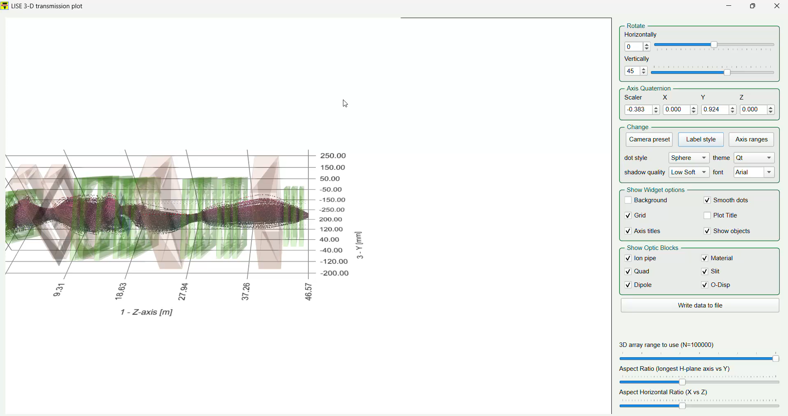
Final Animation Page

