Slide 1
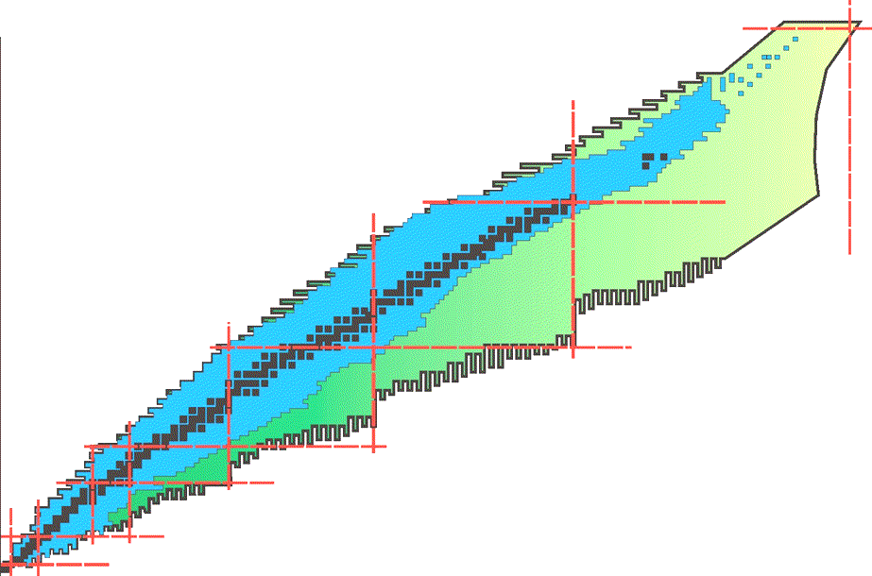
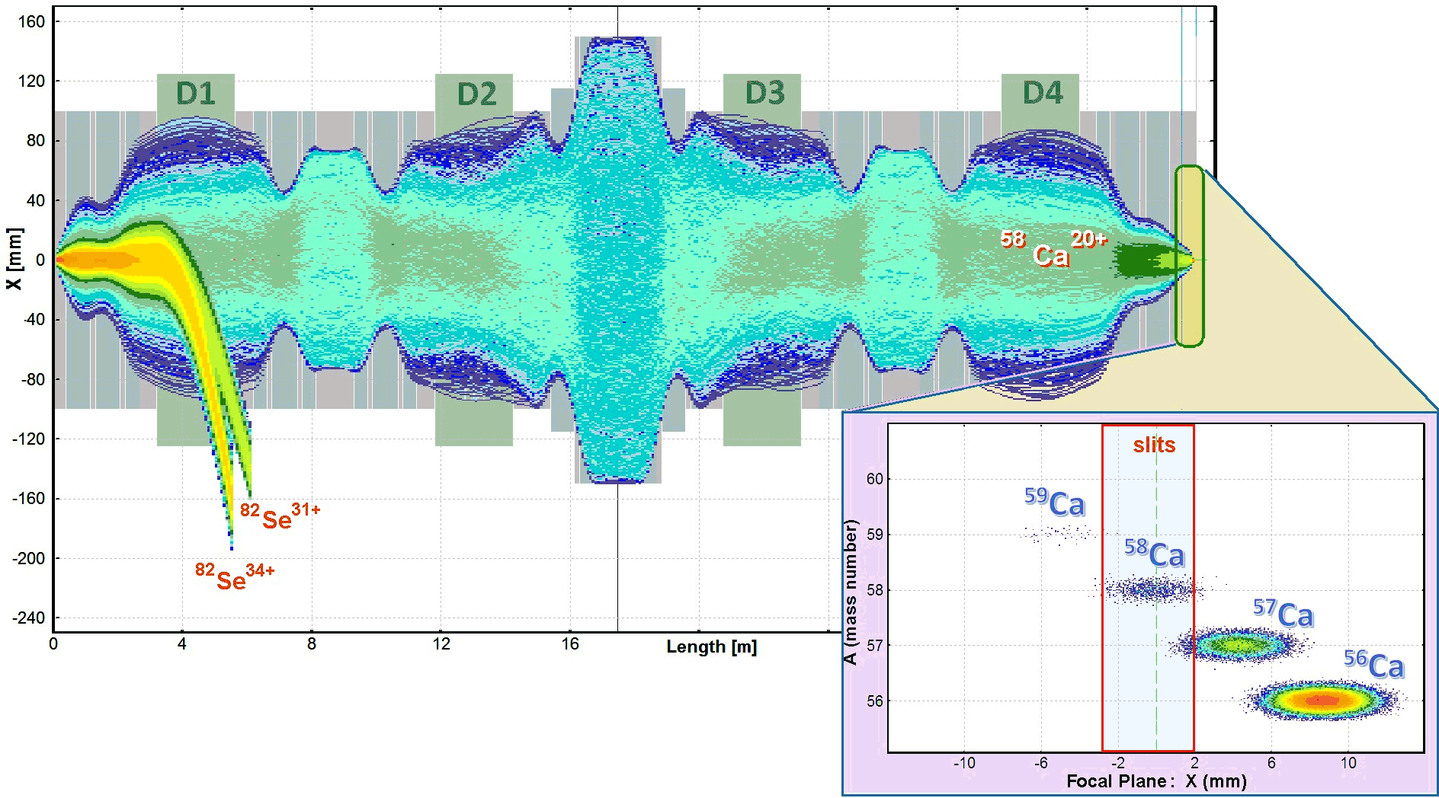





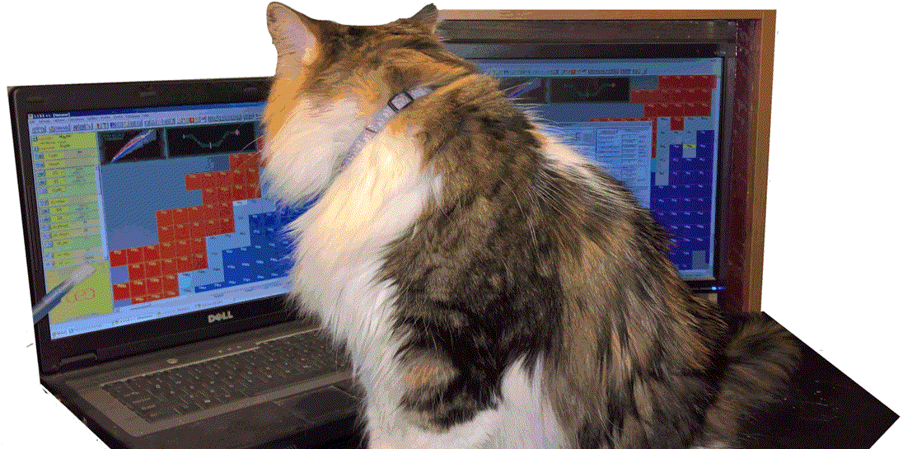


LISE⁺⁺ pictures studio presents
How to Make Rare Isotope Beams at Home
Oleg B. Tarasov
FRIB/NSCL Staff Information Talk
04/04/2018
Notes:
LISE Pictures Studio Presents: How to make rare isotope beams at home (slow phrase + 3 sec)

Slide 2

Sense of humor
with all my deep respect for my scientific supervisor,
who has a great sense of humor,
who knows the story and some details of this presentation,
who helped me with the preparation,
but has not seen yet it.
I hope he’ll have fun.
Notes:
Sense of humor is a value we like to share here, and hope you will have fun

Slide 3

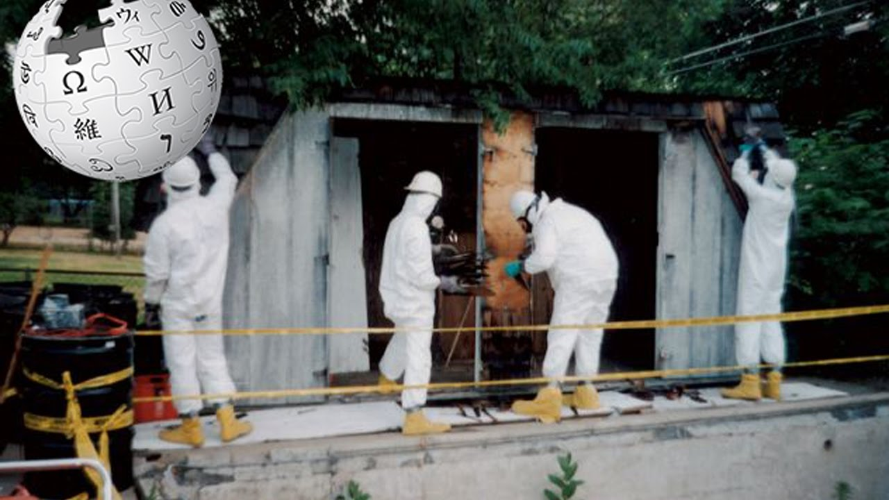
Keyword: “Home”
Domestic research
How to Make Rare Isotope Beams at Home
.. in Michigan…
Notes:
There have been some who have already gone ahead and created their own experiments at home. Please do not follow their way!

Slide 4
ISO 14001
Environmental
management
How to Make Rare Isotope Beams at Home
Keyword: “Home”
Our case with rare beams at home will not create
a danger to you, your housemates, your pets,
your property, even your neighbors !!!
.. in Michigan…
Notes:
However in our case, rare beams at home will not create a danger to you, your housemates, your pets, your property, or even your neighbors

Slide 5
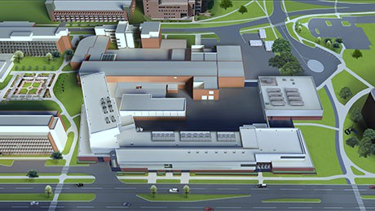
How I see that
after a hard day's work…
Notes:
After a hard days work we head home to get some rest..

Slide 6




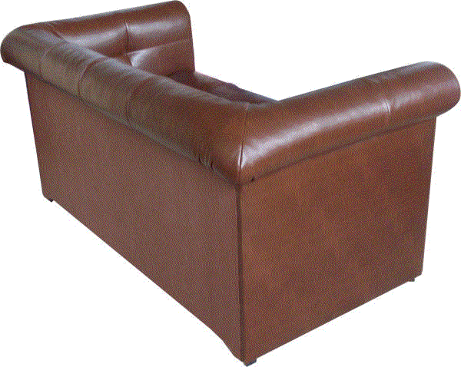
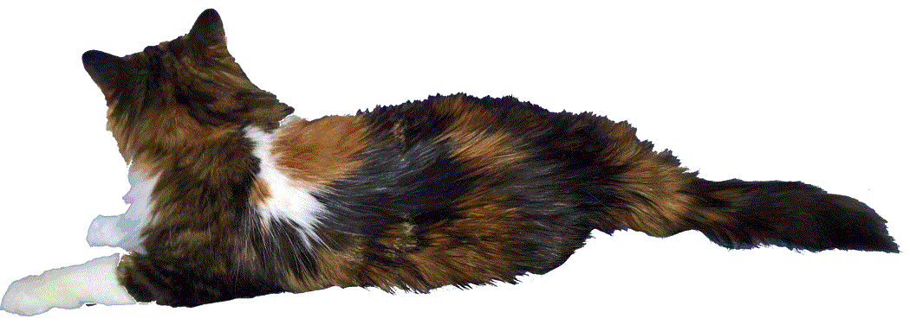
Today is our day?
Notes:
And we turn on the TV to watch our favorite sports team

Slide 7



May be the next time….
athlonsports.com
Notes:
It doesn’t look like we’re doing too good. Our brackets are gone…

Slide 8


Well-known Spartans fan
…. and suddenly!
not in a good mood, we begin to quickly switch between channels
Notes:
not in a good mood, we begin to quickly switch between channels. So we switch over to the discovery channel… and suddenly!

Slide 9

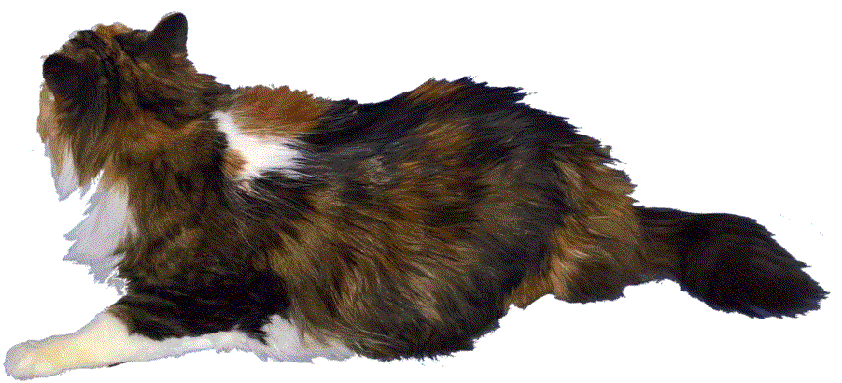
Nucleosynthesis and stellar evolution in the cosmos
Nuclear reactions in stars and stellar explosions generate energy and are responsible for the ongoing synthesis of the elements. They are, therefore, at the heart of many astrophysical phenomena, such as stars, novae, supernovae, and X-ray bursts.
MSUCL-1345
Pictures from Rare Isotope Rap - alpinekat
Notes:
And we find a program about Nucleosynthesis and stellar evolution in the cosmos– text then plays

Slide 10
Nucleosynthesis and stellar evolution in the cosmos
Nuclear reactions in stars and stellar explosions generate energy and are responsible for the ongoing synthesis of the elements. They are, therefore, at the heart of many astrophysical phenomena, such as stars, novae, supernovae, and X-ray bursts.
MSUCL-1345
Notes:
And we find a program about Nucleosynthesis and stellar evolution in the cosmos– text then plays

Slide 11
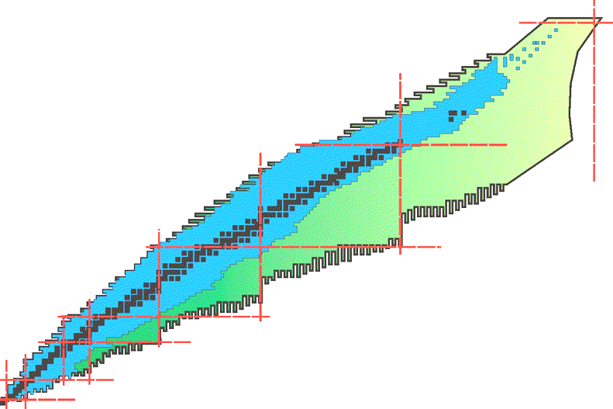
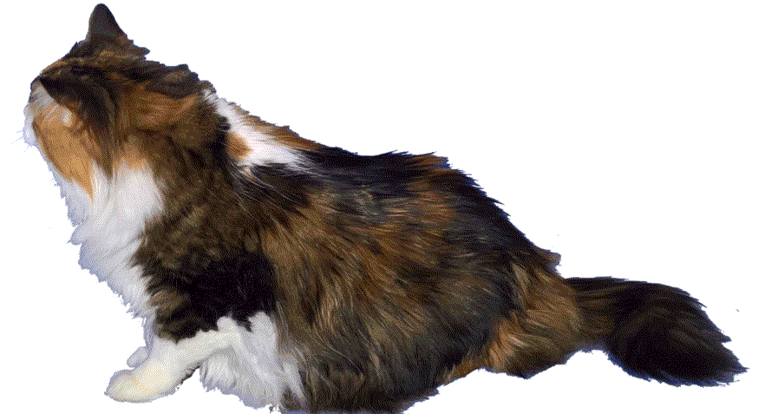
Terra incognita
Around 260 stable isotopes are found in nature (>1Gy)
Less than 1000 isotopes were known in 1966, currently about 3000 (blue) isotopes have been observed
New territory (Terra incognita) to be explored with next-generation rare isotope facilities like FRIB
They will produce more than 1500 NEW isotopes at useful rates and make over 4500 available for studies
Terra Incognita
Note, from slide to slide
the cat is moving to the TV…
Notes:
Text plays

Slide 12
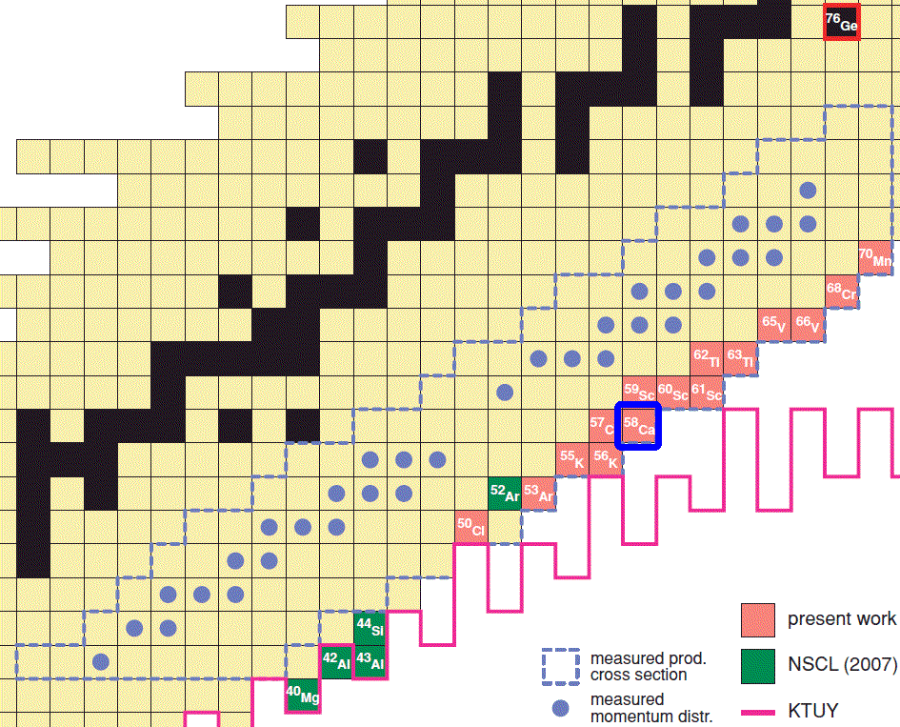
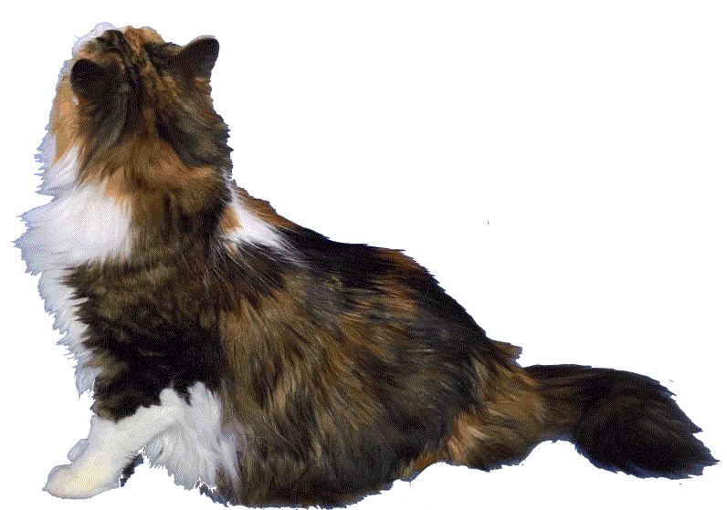
⁵⁸Ca @ NSCL
What is heaviest calcium isotope?
How make it and other rare isotopes?
What isotopes can be first observed in FRIB?
Let’s consider ⁵⁸Ca isotope production as an example.
Why is ⁵⁸Ca interesting? Magic Z=20, subshell at N=34
⁵⁸Ca is one of the heaviest known calcium isotopes*,
and furthermore was observed for the first time at MSU.
* since 2018 the known limit is ⁶⁰Ca.
O.B.Tarasov et al., PRL 121, 022501 (2018)
Notes:
Text plays

Slide 13


You've Got Mail
Learn how to make rare isotope beams.
Do you know how to use email?
Then you can learn how to make a rare isotope.
It is that simple.
Learn how.
Notes:
Text plays

Slide 14
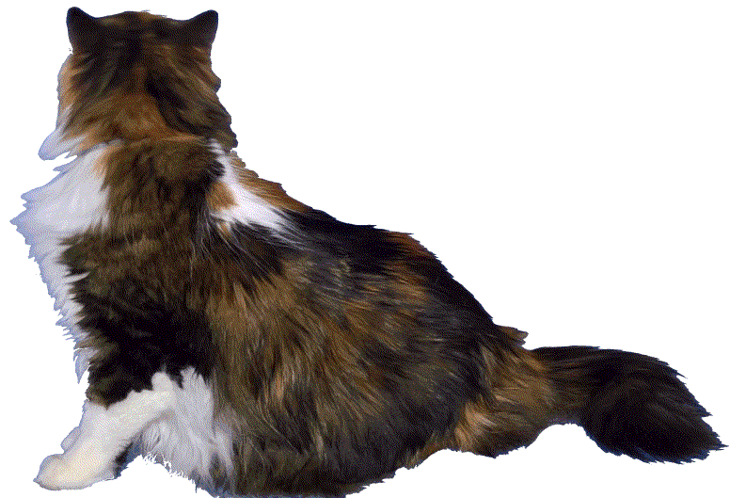
L I S E ⁺⁺
To estimate ⁵⁸Ca isotope production we will use our powerful tool to plan an experiment with rare isotope beams: the program LISE⁺⁺
The LISE⁺⁺ code has been developed to calculate the transmission and yields of fragments produced and collected in a spectrometer.
Notes:
Text plays

Slide 15
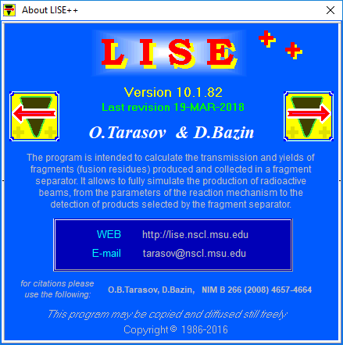
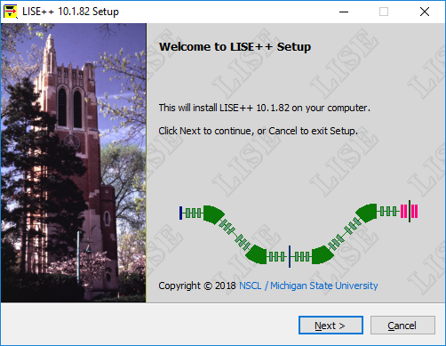
LISE⁺⁺ : Introduction
LISE⁺⁺ is maintained by LISE⁺⁺ group @ Michigan State University and is freely available and distributable through the LISE⁺⁺ website: <http://lise.nscl.msu.edu>.
The LISE⁺⁺ package (including codes PACE4, Global, Charge, MOTER, GEMINI, ETACHA4, Spectroscopic Calculator) operating on MS Windows environment
Currently the LISE⁺⁺ software suite is undergoing a major transportation to a new graphics framework in order to support modern compilers and computing methods.
(since 2021 operates on Linux, macOS)
Notes:
Here’s an introduction to our LISE++ package, which maintained by LISE++ group @ Michigan State University and is freely available through LISE site. Besides the LISE code, The LISE⁺⁺ package including codes PACE4, GEMINI, Global, Charge, MOTER, ETACHA4

Slide 16
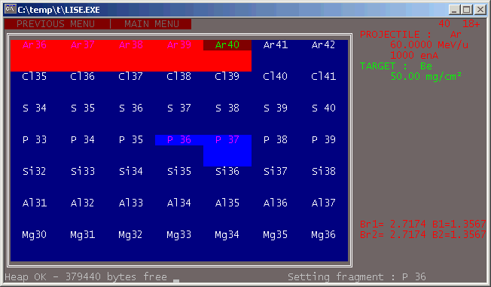
LISE⁺⁺ history : DOS-version
Named after the LISE separator @
1990-1992
D.Bazin, MSU
O.Sorlin, Orsay
v.2.1-2.3
1986-1990
D.Bazin, GANIL
v.1.0-1.*
1994-1997
O.T., GANIL/Dubna
v.2.3 – 2.9
LISE → Ligne d’Ions Super Epluches (fr) (Line of full-stripped ions)
LISE REFERENCE MANUAL
Version 2.2 - June 8, 1992 ….
LISE is a DOS-based software running on any IBM compatible PC. It runs under DOS 3.1 and following versions, and only needs 640 kbytes of memory. The speed of the program depends greatly on the CPU type, speed and configuration. The use of a co-processor is greatly recommended: the program uses FFT (Fast Fourier Transform) algorithms which contain extensive floating-point operations.The last version has been developed on a 386-SX at 16 MHz with a co-processor which provides a reasonable speed (about 1 second per transmission calculation).
In 1998 the MS-DOS version with 14 C++ files and
less than 10 000 lines of code,
and grew on MS Windows (2016) to
615 files, about 400 000 lines,
and size of ~69 MB after Installation.
Notes:
Along with some history on how it was brought up. Started in mid-80s at GANIL by Daniel, then in mid-90s supported by Oleg. Initially LISE operated on MS-DOS, and consisted only 14 C++ files. Currently the entire package more than 3000 files in total and contains more than a million lines in the source.

Slide 17
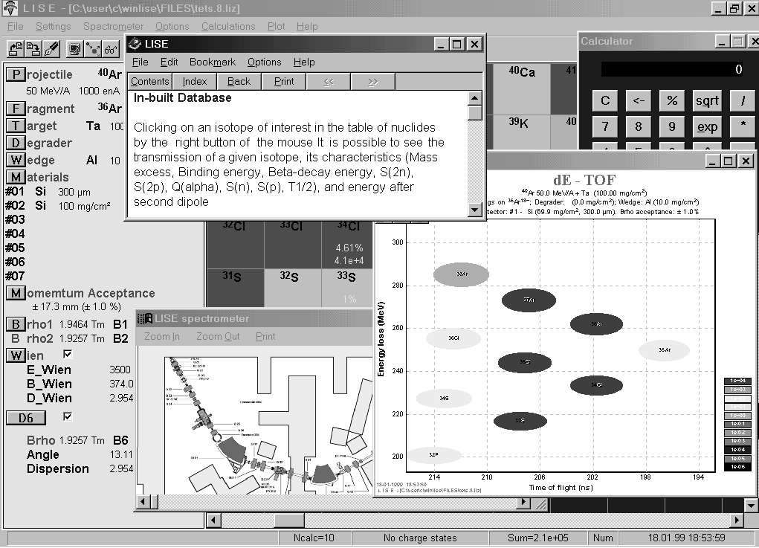
LISE⁺⁺ history : MS Windows
1998
O.T., GANIL/Dubna
v.3.1
2001
NSCL / MSU
v.4.10 –5.12
Active development of the LISE code stimulated by B.Sherrill.
Abrasion-Ablation model construction
LISE operates under MS Windows
2003
NSCL / MSU
v.6
LISE⁺⁺ is the new generation of the LISE code, which allows the creation of a spectrometer through the use of different “blocks”.
RF separation system.
Abrasion – Fission.
1999-2000
O.T., GANIL
v.3.2-4.9
Active development of the LISE code stimulated by M.Lewitowicz
20...
NSCL / MSU
v.7-10
Fusion – Fission
Monte Carlo calculation of fragment transmission
Optics calculation up to 2nd order Beam Optics Optimization (incl. 2nd order)
LISE
LISE⁺⁺
Feel the
difference...
2018
NSCL / MSU
v.10.1
Wider opportunities
0.84”
0.93”
Notes:
In1998 LISE started operating under MS Windows, and in 2001 the LISE development moved to Michigan State University. In 2003 : LISE++ became the new generation of the LISE code, which allows the creation of a spectrometer through the use of different “blocks”. Different reaction mechanisms as Fusion-Residues, Fusion-Fission, Abrasion—Fission, Coulomb Fission have been implemented in the code

Slide 18
LISE⁺⁺ : Statistics, Geography
Notes:
Including growing LISE site statistics. Pay attention, that according this statistics people in Laboratories use to work hard on Tuesday and Wednesday, but not on Friday

Slide 19
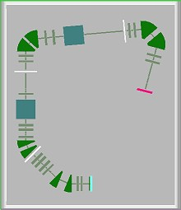
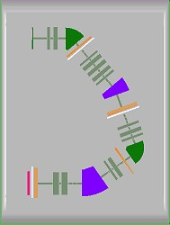
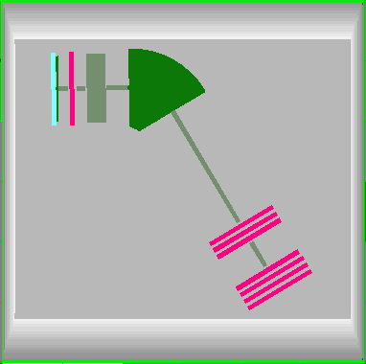
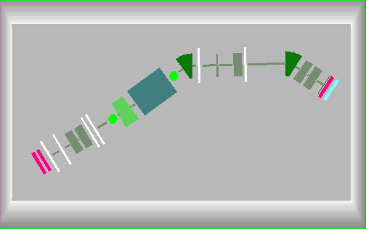
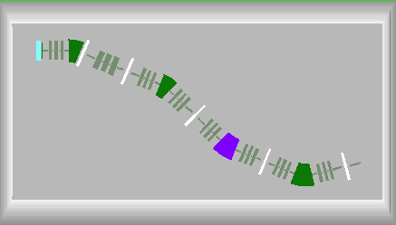
Application : Energy region and Facilities
MARS,
TAMU, USA
SECAR, MSU
DRAGON, Canada
PRISMA, Italy
The LISE⁺⁺ code may be applied at low, medium, and high-energy facilities (fragment- and recoil-separators with electrostatic and/or magnetic selections).
SHELS, Russia
S³, France
BigRIPS+ZeroDegree, Japan
SuperFRS_HEB, Germany
Notes:
The LISE⁺⁺ code may be applied at low, medium, and high-energy facilities (fragment- and recoil-separators with electrostatic and/or magnetic selections). A lot of separator configurations have been developd and implemented in the LISE package

Slide 20
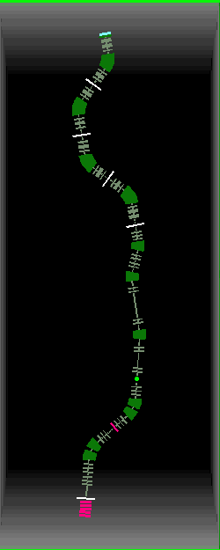
Fragment Separator Construction
with different sections called "blocks" (magnetic and electric multipoles, solenoid, velocity filter, RF deflector and buncher, material in beam, drift, rotation element, and others).
a user-friendly interface that helps to seamlessly construct a fragment separator from the different blocks.
Magnetic dipole (to bend)
Magnetic quadrupole (to focus)
Detector
Slits (to select)
Configuration: A1900_S800BL
(2nd order) 164 blocks
Notes:
LISE provides a way to construct a fragment separator from different blocks as magnetic and electric multipoles, solenoid, velocity filter, RF deflector and buncher, material in beam, drift, rotation element, and others. a user-friendly interface that helps to seamlessly construct a fragment separator from the different blocks.

Slide 21
LISE⁺⁺ package
Besides analytical calculation of the transmission and yields of fragments
Notes:
Besides analytical calculation of the transmission and yields of fragments, LISE also has additional, powerful tools, such as Monte Carlo simulation, Ion optics calculation and optimization, and a variety of internal calculators working with Physical, Kinematics, Evaporation, and Radiation residue. Some well-known codes such as PACE, ETACHA, GLOBAL, and CHARGE have been imported to C++ and implemented in the package

Slide 22

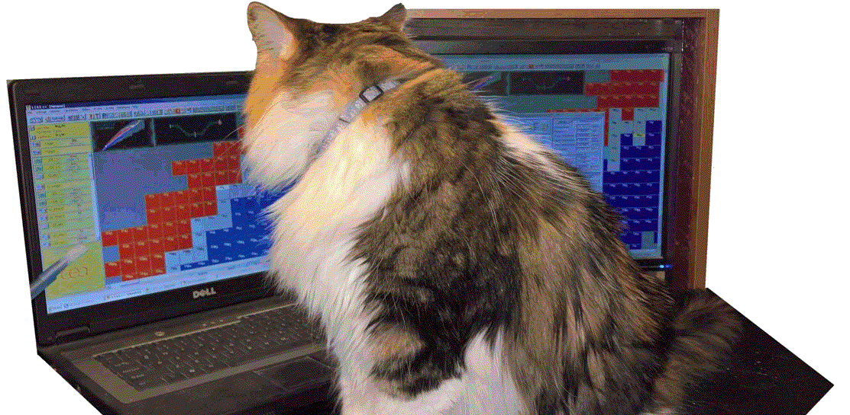
Are you ready?
Notes:
Are you ready? Let’s get started rare isotope beam production!

Slide 23
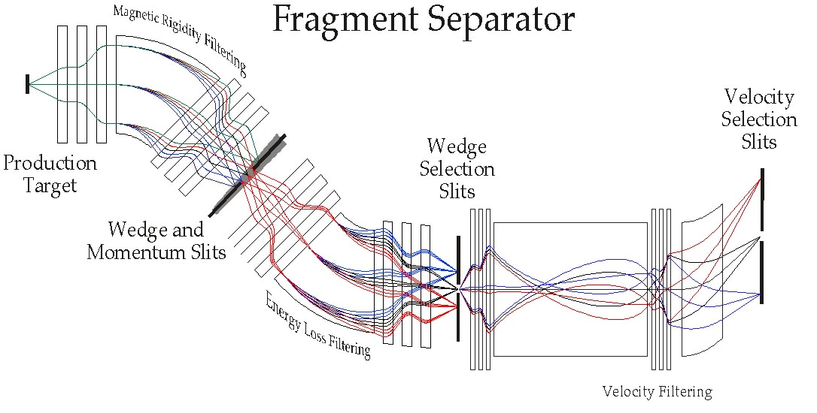

Rare isotope beams: Basic principle of operation
1. Production
3. Registration,
Identification
2. Separation
Notes:
We begin with the basic principles of creation of rare isotope beams.: Production, Separation, Registration and Identification

Slide 24
1
Production
Notes:
Production

Slide 25
Production
Fragment of interest ⁵⁸Ca
Choice of place for the experiment A1900 @ NSCL default configuration
Settings
  Reaction mechanism Projectile
  fragmentation > 95% experiments @ MSU
  Beam
  Target
  Charge state model no charge states assumed at these energies in this Z-region
  Energy loss model default ATIMA
  Secondary reactions in target no assumed at these energies
Notes:
For example we are interested in production of 58Ca isotope. First of all it is necessary to choose the laboratory and setup where to perform your study.
In the case of Michigan Stat university, the reaction mechanism is Projectile fragmentation. Then it is necessary to specify target and beam

Slide 26
Projectile Fragmentation
abrasion
ablation
projectile
target
projectile-like excited fragment
final fragment
Potential beams
⁷⁰Ge (38n+32p)
⁷⁶Ge (44n+32p)
-10p
-10p
-6n
Beam should be a stable isotope
with more neutrons and protons
What is more probable:
To strip 10p and 6n or only 10p?
What factor?
⁵⁸Ca
⁵⁸Ca (38n+20p)
Duke or Kansas? What score?
Notes:
Projectile Fragmentation represents the two-step reaction of abrasion and ablation. In the first stage we have to abrade our projectile, therefor a beam should have more or equal protons and neutrons than the fragment of interest. As you can see from top right plot we can select Ge stable isotopes as 70 and 76. Question: With what isotope you can produce more 58Ca fragments? What is more probable: To strip 10p and 6n or only 10p? What factor?

Slide 27
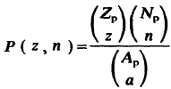
Primary beam choice
What is more probable:
To strip 10p and 6n or only 10p?
What factor?
⁷⁰Ge (38n+32p) → -10p → P = 2.1e-5
⁷⁶Ge (44n+32p) → -10p,-6n → P = 1.3e-2
P(⁷⁶Ge) / P(⁷⁰Ge) = 600 !!!!
http://www.nscl.msu.edu/users/beams.html
What beam from the NSCL list of available beams is more favorable to obtain a ⁵⁸Ca beam?
Conclusion: a primary beam should be more neutron-rich
Notes:
From combinatorics we have a factor 600 for 76Ge over 70Ge. Therefore a primary beam should be more neutron rich in the case of neutron-rich fragment of interest.
In the case of a proton-rich fragment, vice versa, a proton-rich projectile should be chosen. The Primary beam list can be in a Laboratory specified page

Slide 28

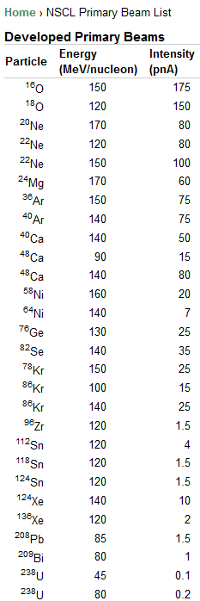
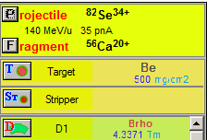
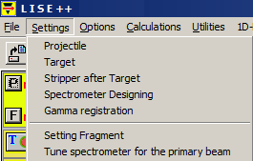
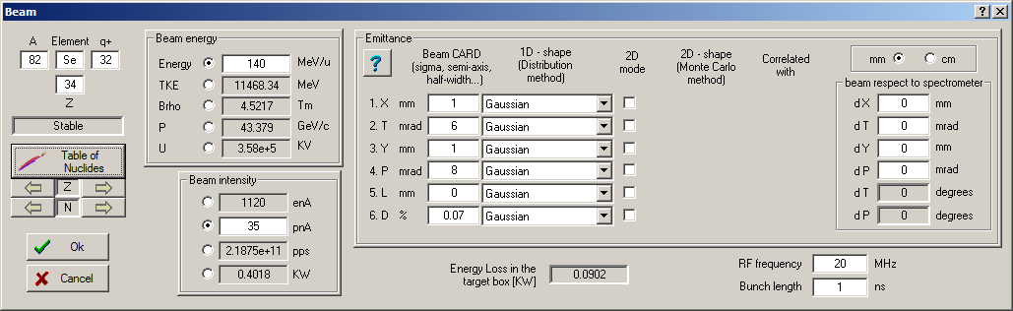
Primary beam settings
What beam from the NSCL list of available beams is more favorable to obtain a ⁵⁸Ca beam?
for all icons in the toolbar and in the production panel
there are corresponding commands in the menu
Answer: ⁸²Se & ⁷⁶Ge are even
We observed 2 events in the
NSCL experiments with a ⁸²Se beam, and with a ⁷⁶Ge beam.
⁸²Se beam is more preferable
to explore nuclei above calcium,
below calcium a ⁷⁶Ge beam.
But, recently the MSU & RIKEN collaboration has observed two ⁶⁰Ca events even with a ⁷⁰Zn beam.
No ⁸²Se and ⁷⁶Ge beams available currently in RIKEN.
So, let’s select a ⁸²Se beam
for our purpose
Notes:
What beam from the NSCL list of available beams is more favorable to obtain a ⁵⁸Ca beam? - the Answer is that an ⁸²Selenium & ⁷⁶Germanium are even. -
We observed 2 events in the NSCL experiments with a ⁸²Se beam, and with a ⁷⁶Ge beam. - So, let’s select a ⁸²Se beam
for our purpose, and enter the corresponding primary beam information to the LISE beam dialog

Slide 29

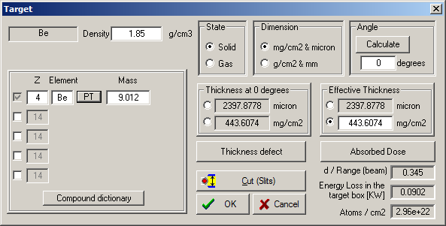
Target settings
Projectile fragmentation case:
    Heavy target : larger cross sections
    Light targets have more nuclei per electron, hence larger nuclear interaction probability at fixed electronic slowing down than heavy target
    Overall case for projectile fragmentation:
    (σ N_{t} ) _{light} > (σ N_{t} ) _{heavy}
    Chemical and physical properties of material
    as melting point, thermal conductivity etc,
    so lifetime of Be target >> lifetime of equivalent Ta target
    Charge state distribution after target:
    light targets provide higher average q of ions
    * using strippers after heavy targets
    Dissipation process larger with heavy targets
    so ⁴⁰Mg and ⁴⁴Si been have observed in ⁴⁸Ca+W
Ratio between target thickness and projectile range (in target)
(range = thickness required to stop a particle)
d/R ~ 0.3-0.35 for maximum fragment yield
Special utility “Optimum target”
    This favors light targets (NSCL uses Be)
Notes:
Next step is a choice of target: based on product of probability of fragment creation (called cross-section) and number of nucleons in a target, Light target are more preferable in projectile fragmentation reactions. Let’s assume initially, target thickness is 30% of range of projectile in a target. Range is a target thickness, that needs to stop a projectile.
Special utility “Optimum target” can be used to calculate a thickness for maximum production fragment rate.

Slide 30
1
Selection
Notes:
Our next basic principle: Isotope Selection.

Slide 31
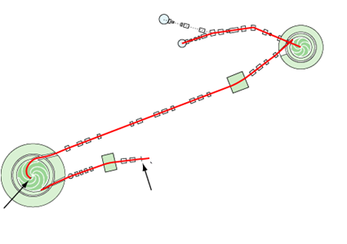
Yield after target
Menu “1D-plot” → “Transmission Characteristics”
ion sources
Example:
⁸²Se→ ⁵⁸Ca
K500
Coupling line
⁸²Se¹³⁺
12.24 MeV/u
K1200
⁸²Se³²⁺
140 MeV/u
0.4 KW
production
target
stripping
foil
How do we select ⁵⁸Ca?
Notes:
Let’s estimate with the LISE code the yield after the target, using a special icon “Calculate transmission for all nuclei”.
Just after the target, the total rate will be 2e11(2hundred billion) particles per second, whereas 58Ca rate has only 1-2 events per day. How do we select ⁵⁸Ca?

Slide 32
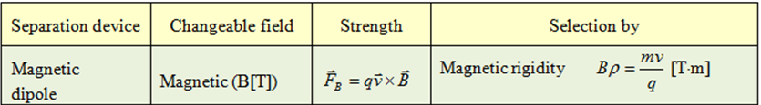
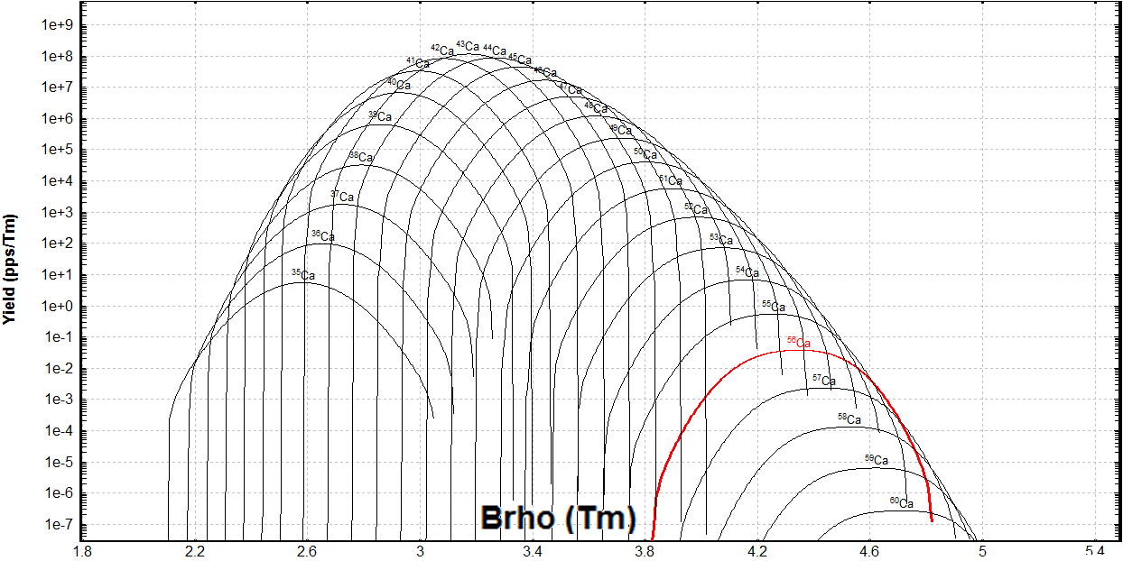
Fragment-separator A1900
magnetic
dipole
max
Changing the I2 slits size,
we change the momentum acceptance
⁸²Se (140 MeV/u) + Be (443mg/cm²) ⇒ **Ca
After target
Settings
on ⁵⁸Ca
Momentum slits
Notes:
For this purpose we are going to use fragment separator A1900. Fragment-separator, is an ion-optical device used to focus and separate products from the collision of ion beams with thin targets. First selection is by magnetic rigidity. We calculate dipole magnetic fields to correspond to momentum of the fragment of interest, and select fragment by slits, named in Figure as momentum slits.

Slide 33
Bρ (magnetic rigidity) selection
Tune separator for setting fragment
After Image2 slits
It corresponds to 2 events/day,
but in reality it will be less (“calcium” anomaly)
Still very high.
DAQ rate should less 1000 cps
Notes:
You can observe the results of Magnetic Rigidity Selection. We have enhanced the ratio of fragment yield to all products by six orders of magnitude.
But it is still not enough, because maximum data acquisition rate should not exceed 1000 counts per second. What is the next step?

Slide 34
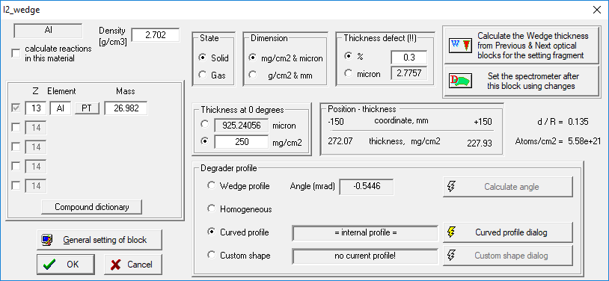
“Wedge” selection (energy loss difference)
www-pdg.lbl.gov
-2.5%
+2.5%
Atomic
number of
fragment
Fragment
velocity
Then higher Z or smaller velocity,
then larger dE/dx (in 10-100 MeV/u energy region)
“Wedge” = wedge-shaped degrader
Notes:
Next step is based on Energy loss difference with use of a wedge shaped degrader. On bottom-right plot you can distribution of residue fragments at the end of a1900 fragment separator.

Slide 35
Wedge selection (energy loss difference)
Tune separator for setting fragment
After Focal Plain slits
Fragment production in wedge
FRIB : the second wedge
separation stage to eliminate
these products
Notes:
Using focal plane slits we can significantly decrease the total rate in detectors. Please see final fragment residues plot on right figure.

Slide 36
Selection summary
After Target
After Image2 slits
Bρ selection
After Focal Plain slits
“Wedge” selection
Notes:
And with all our selection steps, here is a Summary of results after the magnetic rigidity and wedge selections. We can provide purification about 4 trillions with a1900 fragment-separator in the case of 58Ca

Slide 37
1
Registration &
Identification
Notes:
The next our final basic principles are registration and identification

Slide 38
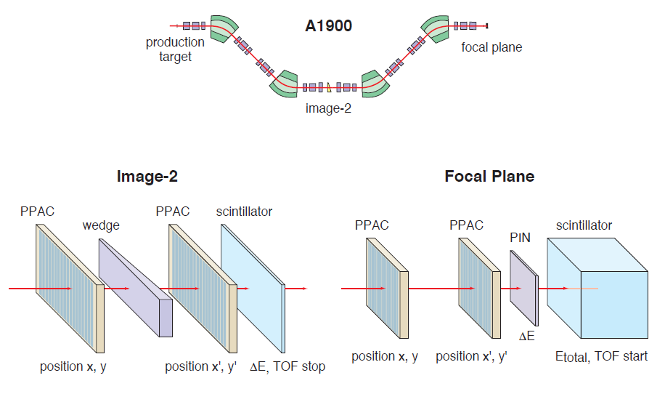
Particle IDentification
What do we want to know?
A
Z
Q
Energy (property of incoming ion in detectors)
What do we measure?
Total kinetic energy
Magnetic (electric) rigidity
Energy loss in detector
Velocity (time of flight)
In our case (low Z, E=140 MeV/u) we assume Q=Z, so we do need only 3 values to measure
Courtesy by A.Stolz
Image-4
Image-4
dE
Magnetic rigidity
Time of flight
TKE
Notes:
The basis of PID, or particle identification:
What do we want to know about particles? What does it mean : we identified a particle? It means , we know mass, elemental and ionic charges, and its energy.
What can we measure? Total kinetic energy, Magnetic rigidity, energy loss in a detector, and Velocity (based on the time of flight) .
((If we need characteristics to know, then at least 4 values we have to measure.)) If we need to know characteristics, then we have to measure at least 4 values. In our case at low Z and Energy at 140 MeV per nucleon, we can assume Z (the elemental charge) is equal to q (the ionic charge), and we need to measure only 3 values.
We obtain the magnetic rigidity of a fragment with position measurement in the dispersive focal plane (named Image 2).
Time of flight is measured between detectors located at Image2 and Image 4, and the energy deposition correspondingly by detectors at Image 4

Slide 39
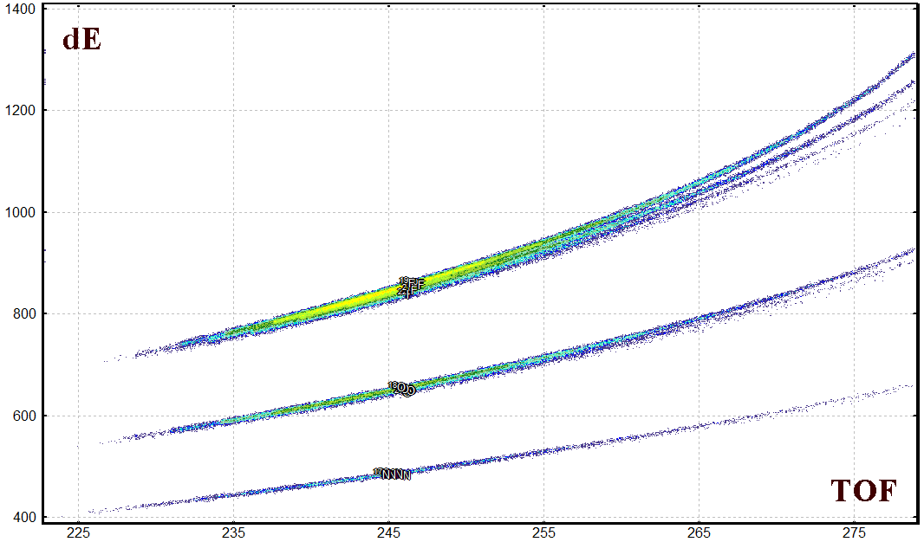
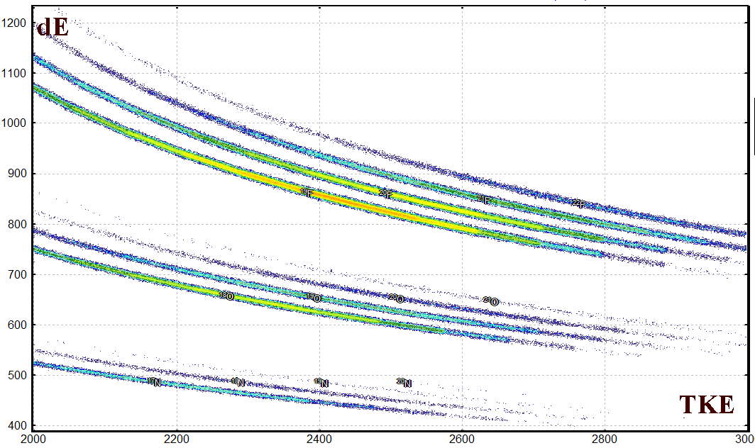
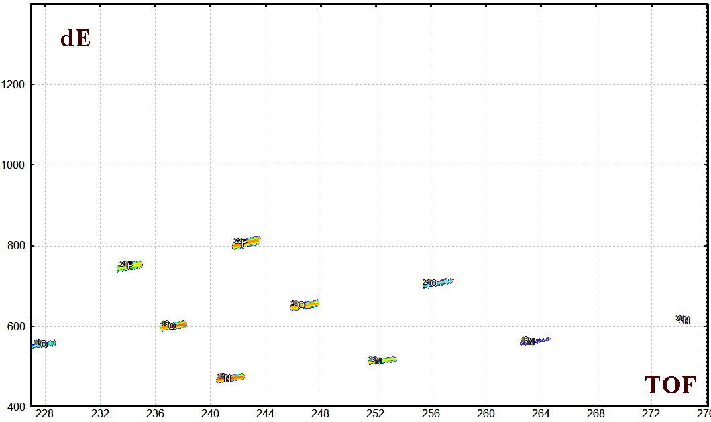
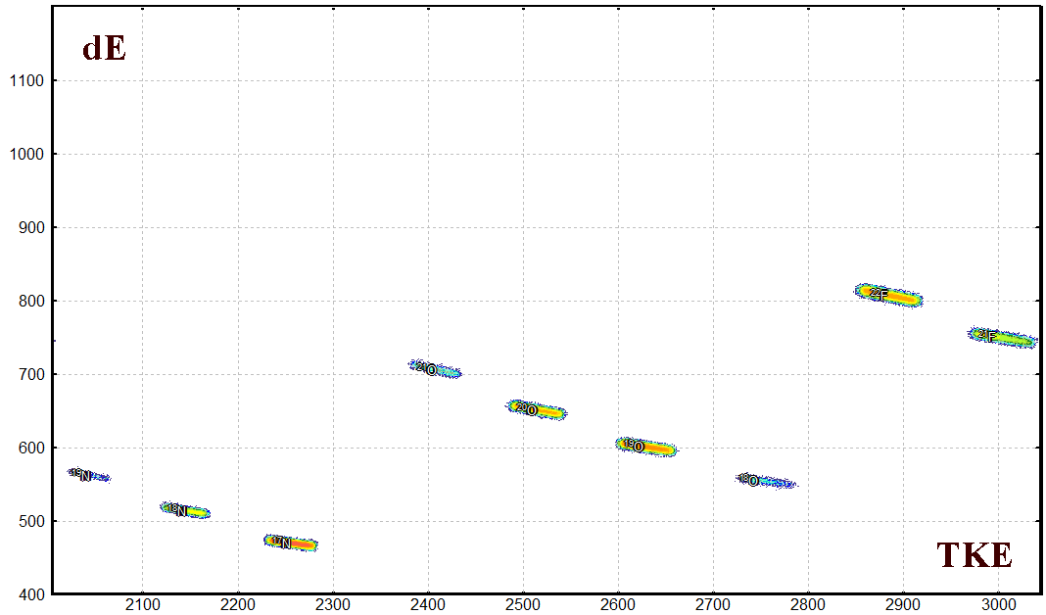
Correlation plots and Bρ-selection
100% momentum acceptance
No isotope separation
²²F
²¹F
²⁰F
²¹O
¹⁹F
F
²⁰O
¹⁹O
¹⁸O
¹⁹N
Ne
¹⁸N
O
¹⁷N
Δp/p=0.6%
Settings on ²⁰O
Good isotope separation
²²F
²²F
²¹F
²¹F
²¹O
²¹O
²⁰O
¹⁹O
²⁰O
¹⁹O
¹⁸O
¹⁹N
¹⁹N
¹⁸O
¹⁸N
¹⁸N
¹⁷N
¹⁷N
Notes:
Here we can see Correlation plots versus magnetic rigidity. The Top plot show Particle Identification plots in the case of full momentum acceptance.
How can it be seen? It is hard to distinguish separation between masses. The situation was changed with small momentum acceptance of 0.6%, but we got a significantly smaller yield of fragment of interest. Is there a way to distinguish isotope separation at a high momentum acceptance?

Slide 40
Obtaining A, Z, q
The atomic number is determined from the combination of energy loss (ΔЕ) and time of flights (TOF) values according to the Bethe formula:
The fragment mass can be extracted in atomic units from the relativistic formula:
where TKE is calculated as a sum of the energy loss values in each of the detectors in a multilayer telescope stopping the products. The charge state (Q) of the ion evaluated from a relation based on the TKE, velocity and magnetic rigidity values:
Notes:
Let’s obtain the values for atomic number, mass, and charge state from measured values: energy loss, time-of-flight, total kinetic energy, and magnetic rigidity, using equations shown in this page

Slide 41
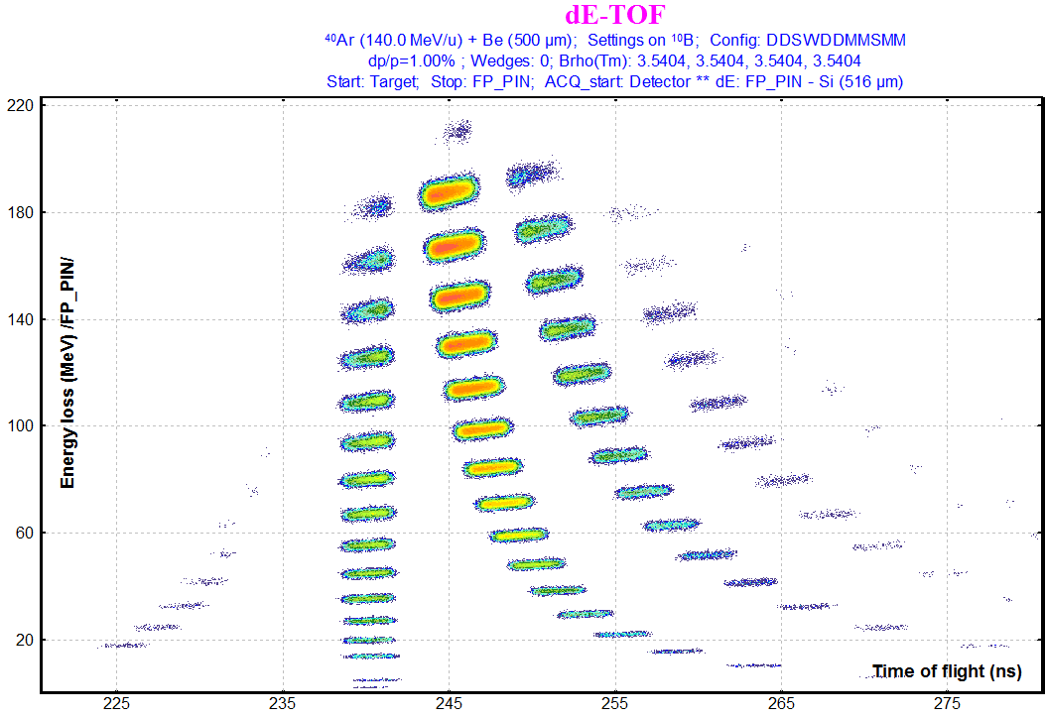
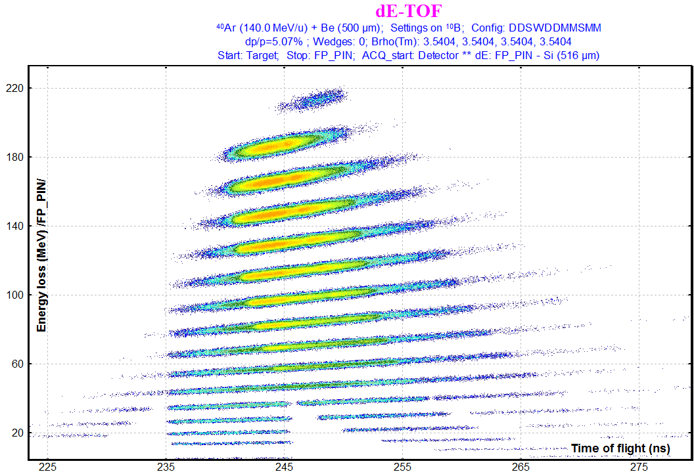
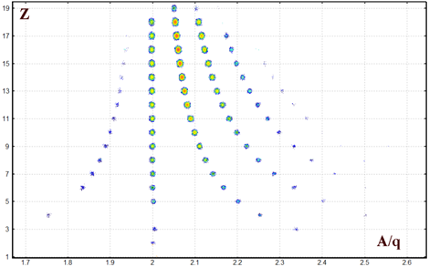
Momentum acceptance
Δp/p=1%
Δp/p=5%
dE
dE
ToF
ToF
Z
Z and A/q resolution will be the same in spite of momentum acceptance value
A/q
Notes:
Elemental and ionic charges , and mass numbers should not depend on momentum acceptance. They are characteristics of an ion. Therefore, applying PID “mathematics” we are able to separate nuclei independently from momentum acceptance.

Slide 42
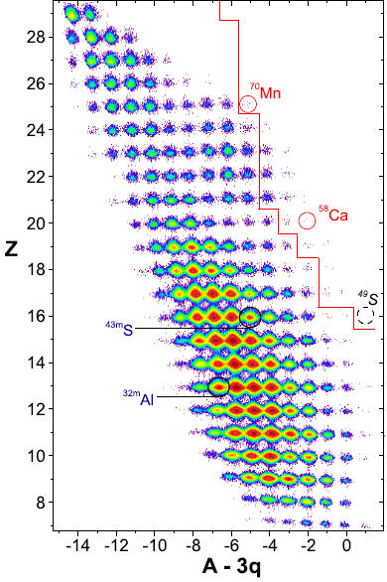
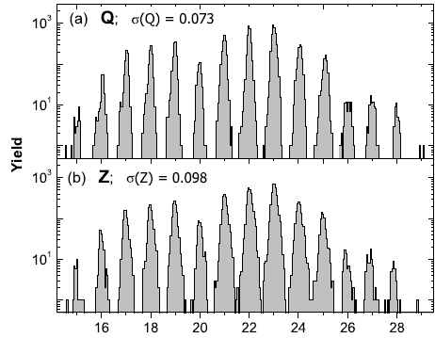
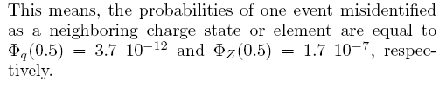
⁷⁶Ge(130MeV/u) + W,Be : PID, resolution
For all particles stopped in the Si-telescope in the production runs
OT et al. Phys.Rev.Lett. 102, 142501 (2009)
OT et al. Phys.Rev.C. 80, 034609 (2009)
Notes:
shown in this slide are particle identification plots obtained in the NS CL experiment with a 76 Germanium beam. The limit of
previously observed nuclei is indicated by the solid red line. 15 isotopes were first observed in this work.

Slide 43
Particle identification assignments
Calibration with the primary beam (or other reference line as sources)
Unbound nuclei in the table of nuclides
Stopped fragment tagging with isomeric gamma-rays
In-flight fragment tagging with prompt gamma
X-ray from ions passing material
Laser induced fluorescence
Precise isobar selection with known masses
Notes:
3 different methods of Particle identification assignments we are planning to discuss here.
Here we are planning to discuss 3 different methods of particle identification assignments

Slide 44
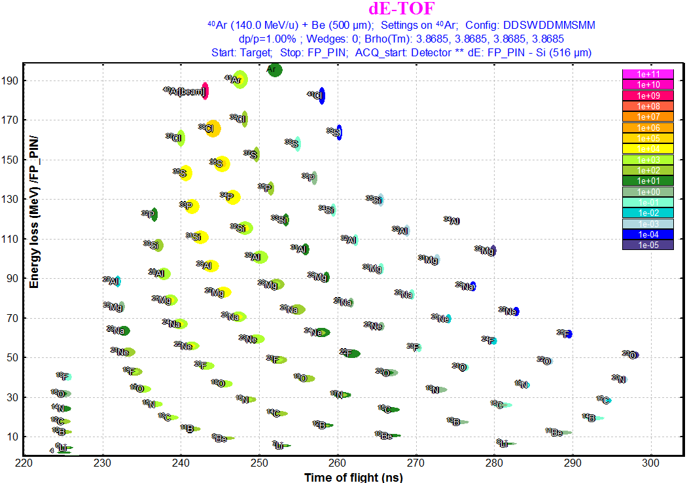
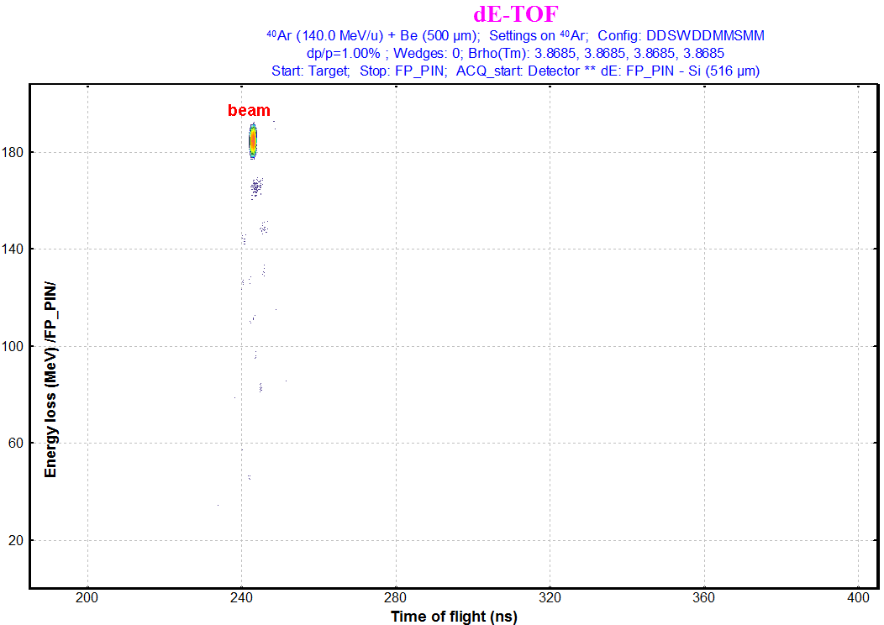
Calibration with the primary beam
Useful then the fragment of interest is close to the projectile
Notes:
Here we can see the Purpose of calibration with primary beam

Slide 45
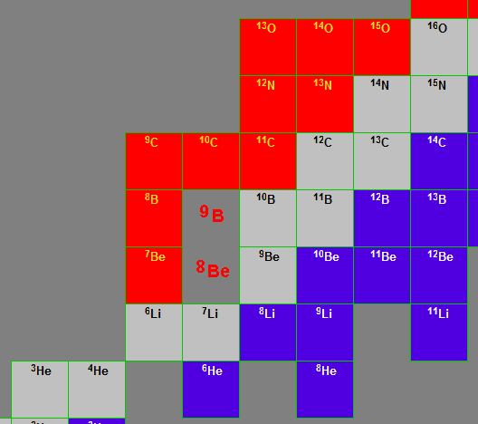
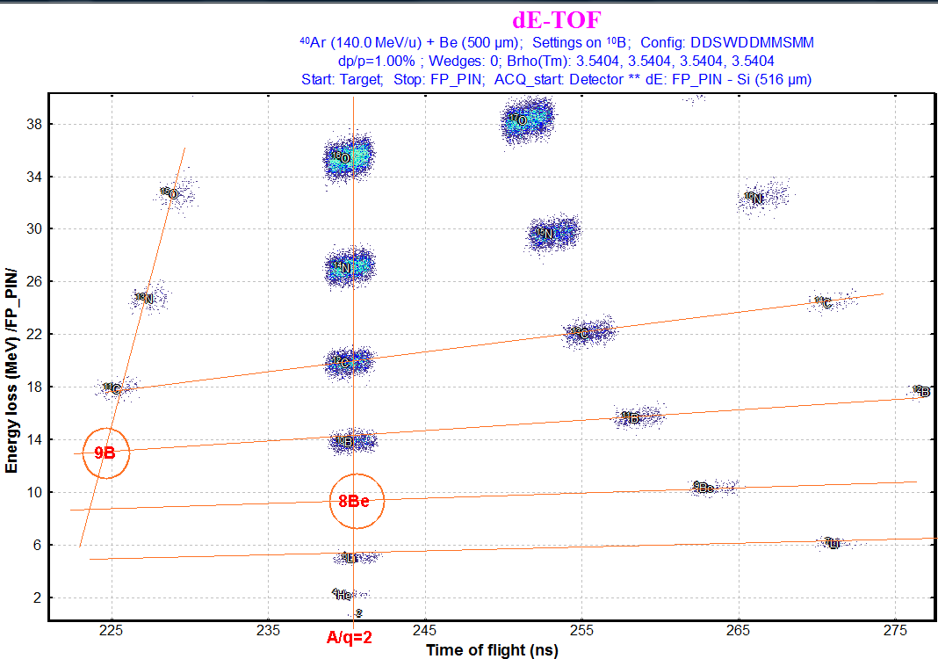
Unbound nuclei in the table of nuclides
Notes:
Shown here, we have Unbound nuclei in the table of nuclides. For example: 8-berrilium, 9-Bohr, 25-oxygen. Empty space in the known pattern can be a proof of PID

Slide 46



Stopped fragment tagging with isomeric gamma-rays
Notes:
Here we have Fragment tagging with micro-second isomeric gamma-rays. Gamma-detectors surround a telescope where particles are stopped.
The Coincidence of registered heavy ions with gamma-rays in a micro-second timing window allows for particle identification verification,
As shown in the next slide

Slide 47


Stopped fragment tagging with isomeric gamma-rays
NSCL #05120
²⁰⁸Pb (86 MeV/u) + Be
Notes:
Here, Gamma-spectrum is measured in the experiment with a 208-lead beam at MSU. Known isomer decay gamma lines are labeled.

Slide 48
Almost finished!
Yes, we did it!
A link on this presentation can be found on the home page of the LISE⁺⁺ site.
There you can also find the “First steps” manual and the detailed course of lectures
"Production of Fast Rare Ion Beams”.
Notes:
Almost finished!
the “First steps” manuals and the detailed course of lectures
"Production of Fast Rare Ion Beams” can be found on LISE⁺⁺ site.

Slide 49





Next Laboratory
Wide Meeting
Questions?
Questions are always good!
⁶²Ca at FRIB.
Where I can find an FRIB fragment separator configuration for LISE⁺⁺ ??
Are you planning
a “Rare isotope
rap” sequel?
Notes:
Any Questions?

Slide 50

The
End
“How to Make Rare Isotope Beams at Home”
Theatrical Release poster
Directed by Oleg Tarasov
Produced by NSCL/MSU, NSF
Story by Oleg Tarasov
Brad Sherrill
Written by Oleg Tarasov
Consulted Brad Sherrill
Alexandra Gade
Starring
Brad Sherrill Cat “Varya”
Production Company LISE⁺⁺ pictures studio
Distributed by “FRIB/NSCL Staff Information Talk” group
Release date April 4, 2018 (United States)
Running time 30 minutes
Images from Rare Isotope Rap by “alpinekat” @ youtube https://www.youtube.com/watch?v=677ZmPEFIXE were used
Notes:
A thank you to all those who have contributed to the Staff Information Talk (+delay)

Slide 51


Video adaptation
The presentation has been adapted to video by
research assistant Alexandra Tarasova
(Computer Science Department of MSU).
This work was supported by the US National Science Foundation
under Grants No. PHY-20-12040 and 23-10078
“Windows on the Universe: Open Quantum Systems in Atomic Nuclei at FRIB”
11/09/2023
Notes:
Do not talk grant number, just name

