Slide 1
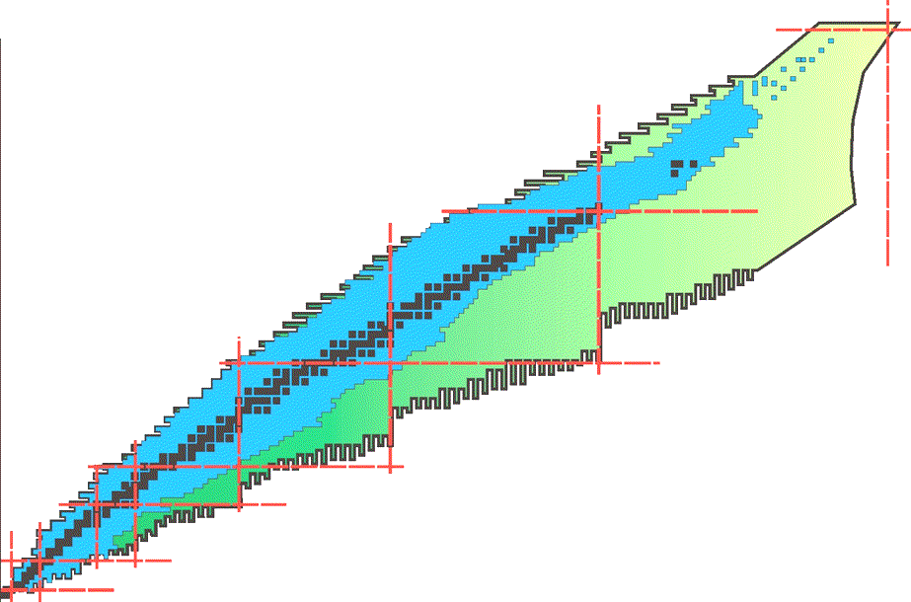
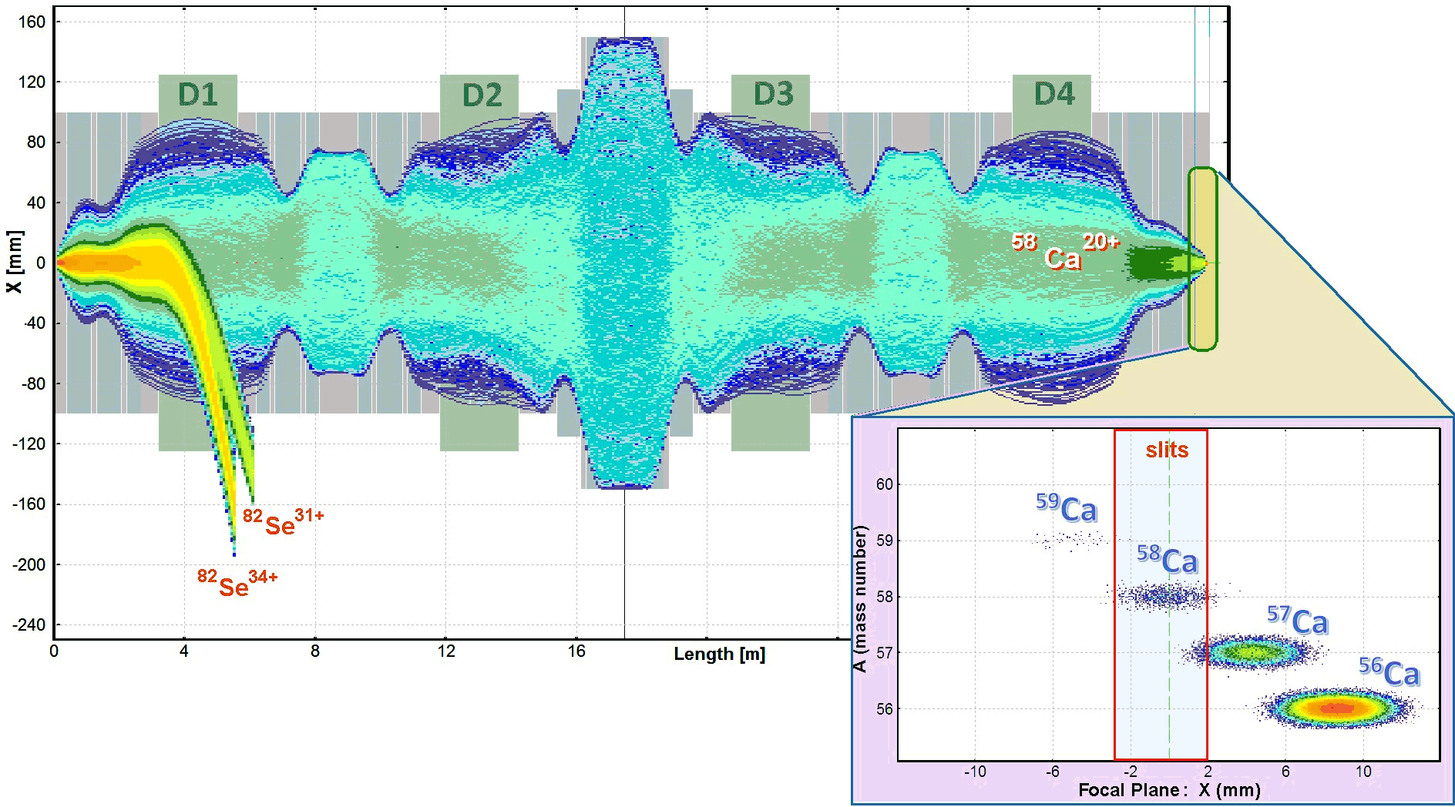




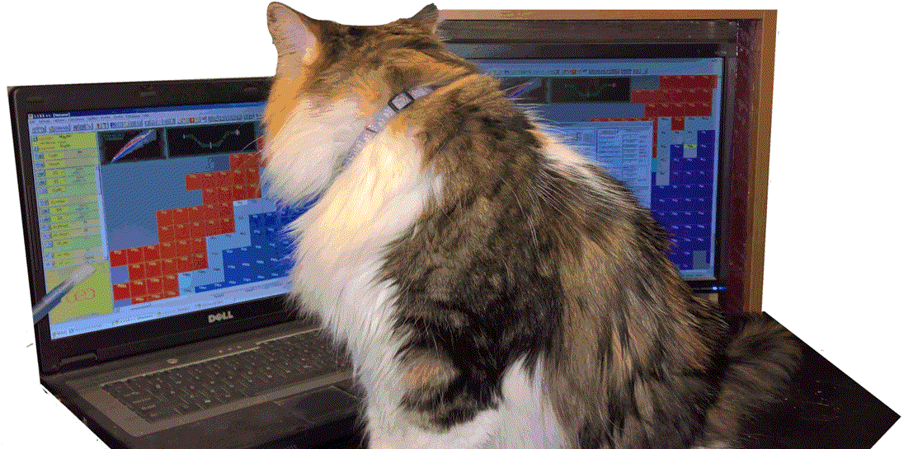


LISE⁺⁺ pictures studio presents
How to Make Rare Isotope Beams at Home
Oleg B. Tarasov
FRIB/NSCL Staff Information Talk
04/04/2018

Slide 2

Sense of humor
with all my deep respect for my scientific supervisor,
who has a great sense of humor,
who knows the story and some details of this presentation,
who helped me with the preparation,
but has not seen yet it.
I hope he’ll have fun.

Slide 3

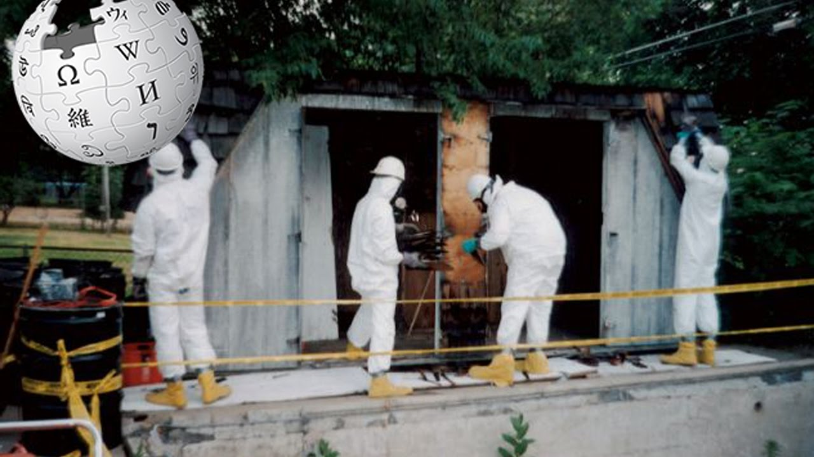
Keyword: “Home”
Domestic research
How to Make Rare Isotope Beams at Home
.. in Michigan…

Slide 4
ISO 14001
Environmental
management
How to Make Rare Isotope Beams at Home
Keyword: “Home”
Our case with rare beams at home will not create
a danger to you, your housemates, your pets,
your property, even your neighbors !!!
.. in Michigan…

Slide 5
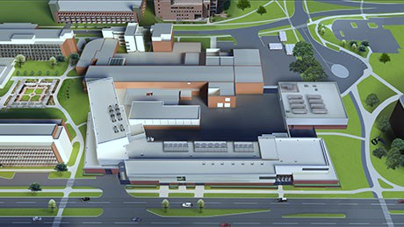
How I see that
after a hard day's work…

Slide 6




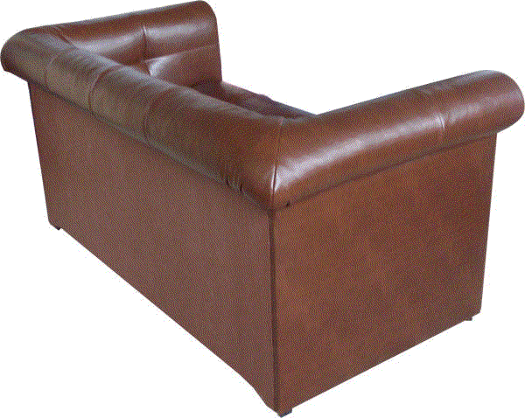
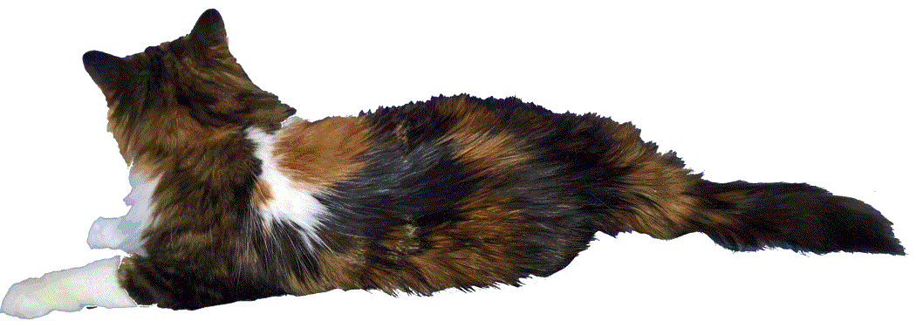
Today is our day?

Slide 7
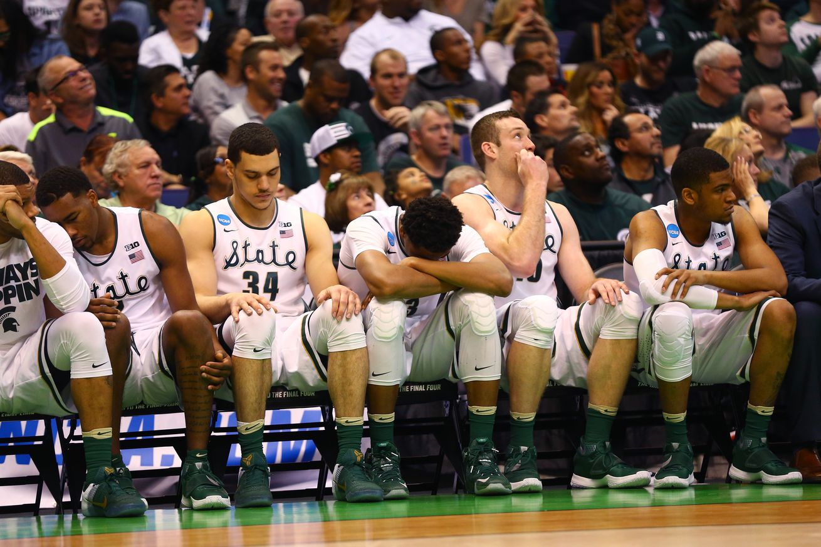

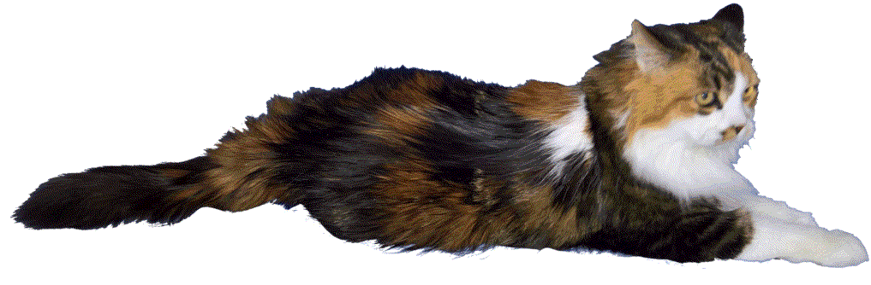
May be the next time….
athlonsports.com

Slide 8

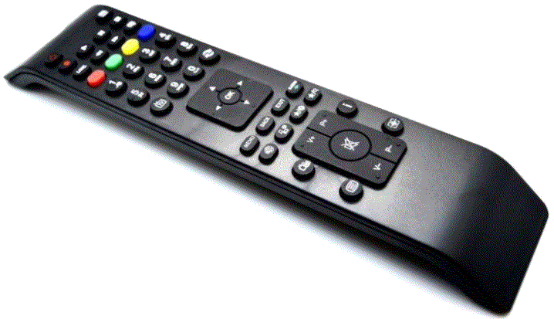
Well-known Spartans fan
…. and suddenly!
not in a good mood, we begin to quickly switch between channels

Slide 9

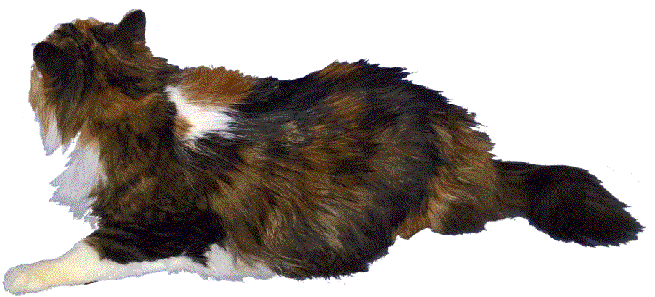

Nucleosynthesis and stellar evolution in the cosmos
Nuclear reactions in stars and stellar explosions generate energy and are responsible for the ongoing synthesis of the elements. They are, therefore, at the heart of many astrophysical phenomena, such as stars, novae, supernovae, and X-ray bursts.
MSUCL-1345
Sorry, I could not find the "original" voice, but at least this voice sounds without my Kirghiz accent

Slide 10
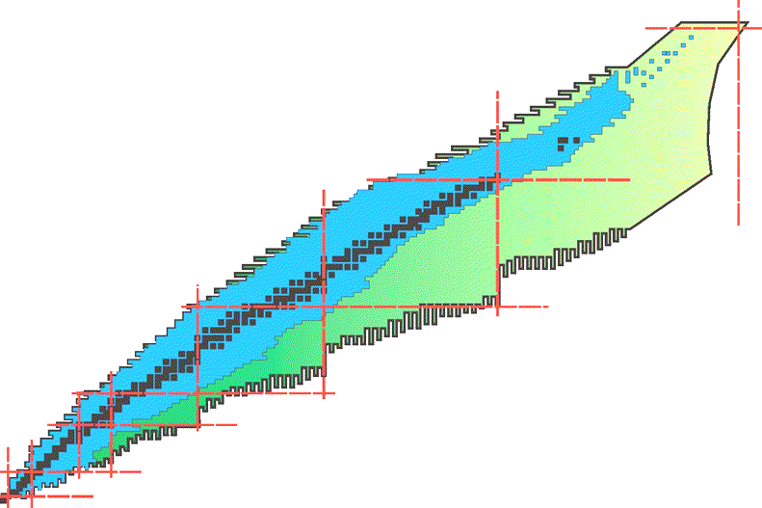
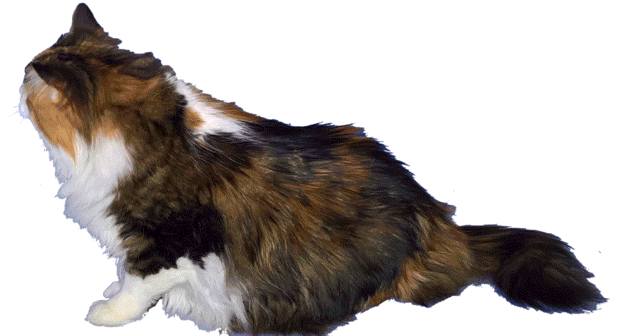
Terra incognita
Around 260 stable isotopes found in nature (>1Gy)
Less than 1000 known isotopes in 1966, currently about 3000 (blue) know isotopes
New territory (Terra incognita) to be explored with next-generation rare isotope facilities as FRIB
They will produce more than 1000 NEW isotopes at useful rates (4500 available for study)
Terra Incognita
British accent.. Surprise!
Note, from slide to slide
the cat is moving to the TV…

Slide 11
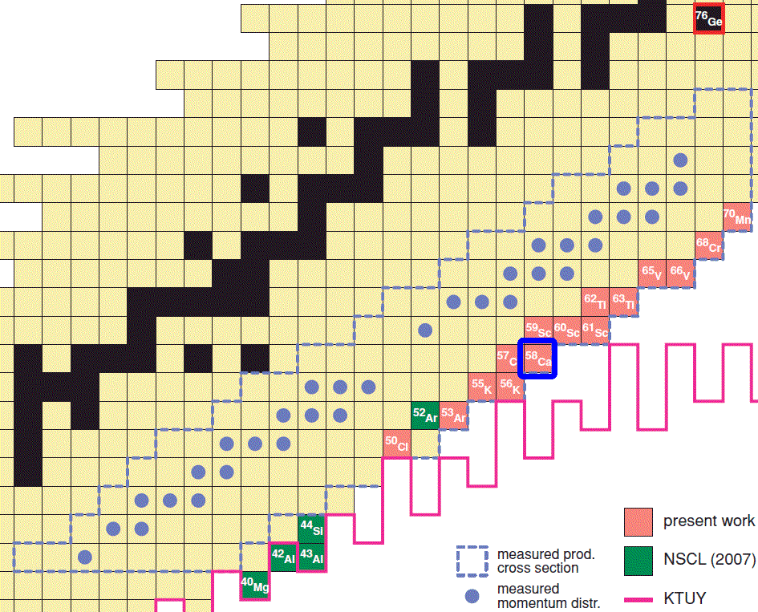
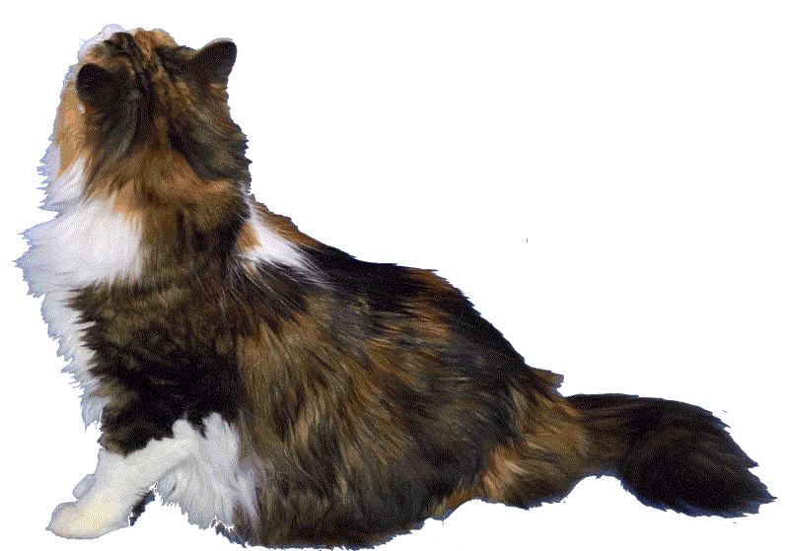
⁵⁸Ca @ NSCL
What is last particle neutron-rich calcium isotope?
How do we produce rare isotopes?
What isotopes can be first observed in FRIB?
Let’s consider ⁵⁸Ca isotope production as an example.
Why is ⁵⁸Ca isotope? Magic Z=20, subshell at N=34
⁵⁸Ca is the last* particle-bound neutron-rich calcium isotope,
and furthermore was observed at the first time several
years ago at MSU. (* officially)
May be it will useful to change the voice to a more pleasant one on the next page?

Slide 12


You've Got Mail
Learn how to make rare isotope beams.
Do you know how to use email?
Then you can learn how to make a rare isotope.
It is that simple.
Learn how.
By the way, Brad came up with these phrases.

Slide 13
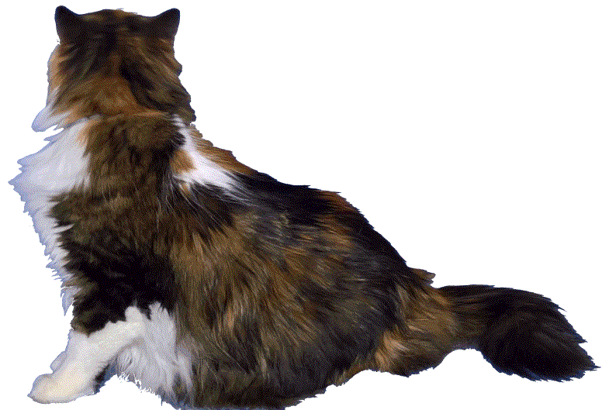
L I S E ⁺⁺
To estimate ⁵⁸Ca isotope production we will use our powerful tool to prepare an experiment with rare isotope beams: the program LISE⁺⁺
The LISE⁺⁺ code has been developed to calculate the transmission and yields of fragments produced and collected in a spectrometer.
This is the last animated slide.
Sorry for the following inconvenience ....

Slide 14
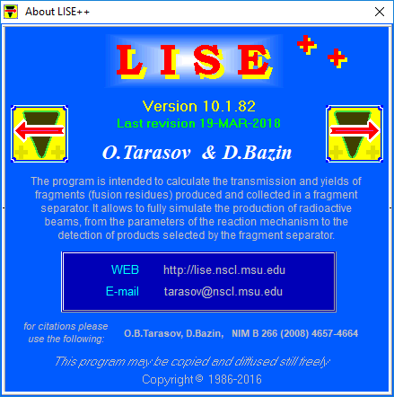
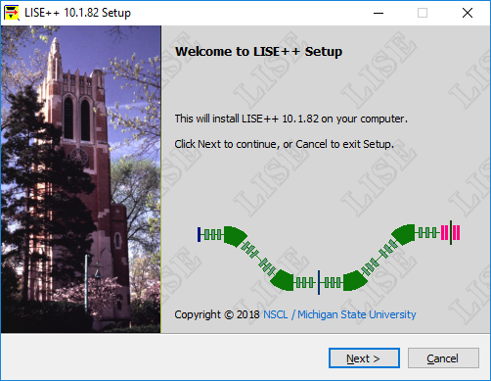
LISE⁺⁺ : Introduction
LISE⁺⁺ is maintained by LISE⁺⁺ group @ Michigan State University and is freely available and distributable through the LISE⁺⁺ website: <http://lise.nscl.msu.edu>.
The LISE⁺⁺ package (including codes PACE4, Global, Charge, MOTER, ETACHA4, Spectroscopic Calculator) operating on MS Windows environment
Currently the LISE⁺⁺ software suite is undergoing a major transportation to a new graphics framework in order to support modern compilers and computing methods.
No hidden bitcoin mining procedures. Travis checked it recently.

Slide 15
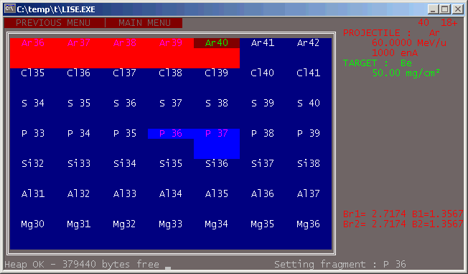
LISE⁺⁺ history : DOS-version
Named after the LISE separator @
1990-1992
D.Bazin, MSU
O.Sorlin, Orsay
v.2.1-2.3
1986-1990
D.Bazin, GANIL
v.1.0-1.*
1994-1997
O.T., GANIL/Dubna
v.2.3 – 2.9
LISE → Ligne d’Ions Super Epluches (fr) (Line of full-stripped ions)
LISE REFERENCE MANUAL
Version 2.2 - June 8, 1992 ….
LISE is a DOS-based software running on any IBM compatible PC. It runs under DOS 3.1 and following versions, and only needs 640 kbytes of memory. The speed of the program depends greatly on the CPU type, speed and configuration. The use of a co-processor is greatly recommended: the program uses FFT (Fast Fourier Transform) algorithms which contain extensive floating-point operations.The last version has been developed on a 386-SX at 16 MHz with a co-processor which provides a reasonable speed (about 1 second per transmission calculation).
In 1998 the MS-DOS version with 14 C++ files and
less than 10 000 lines of code,
and grew on MS Windows (2016) to
615 files, about 400 000 lines,
and size of ~69 MB after Installation.

Slide 16
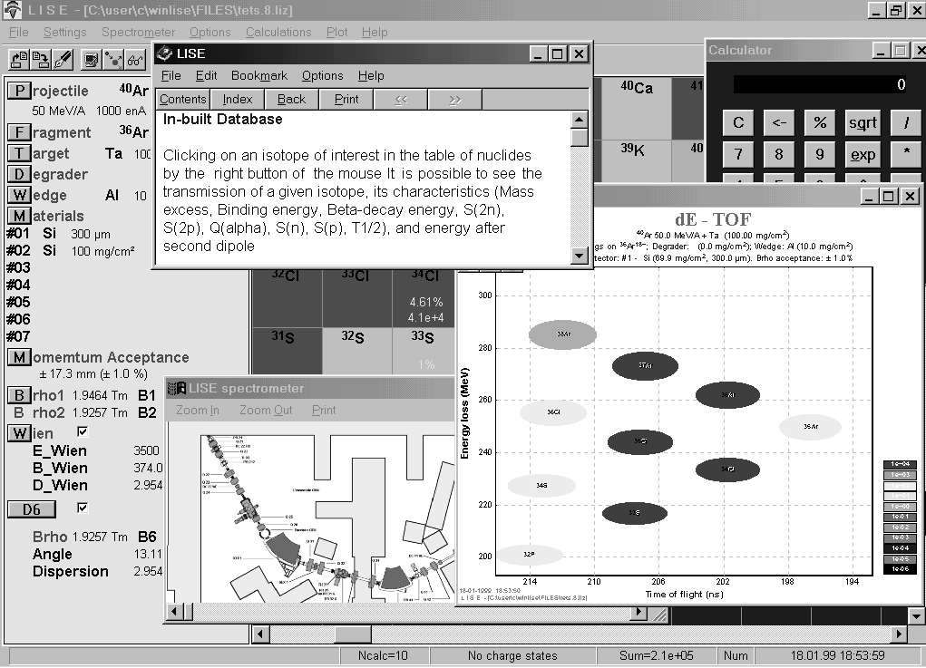
LISE⁺⁺ history : MS Windows
1998
O.T., GANIL/Dubna
v.3.1
2001
NSCL / MSU
v.4.10 –5.12
Active development of the LISE code stimulated by B.Sherrill.
Abrasion-Ablation model construction
LISE operates under MS Windows
2003
NSCL / MSU
v.6
LISE⁺⁺ is the new generation of the LISE code, which allows the creation of a spectrometer through the use of different “blocks”.
RF separation system.
Abrasion – Fission.
1999-2000
O.T., GANIL
v.3.2-4.9
Active development of the LISE code stimulated by M.Lewitowicz
20...
NSCL / MSU
v.7-10
Fusion – Fission
Monte Carlo calculation of fragment transmission
Optics calculation up to 2nd order Beam Optics Optimization (incl. 2nd order)
LISE
LISE⁺⁺
Feel the
difference...
2018
NSCL / MSU
v.10.1
Wider opportunities
0.84”
0.93”

Slide 17
LISE⁺⁺ : Statistics, Geography

Slide 18
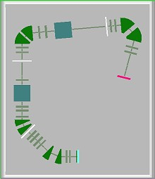
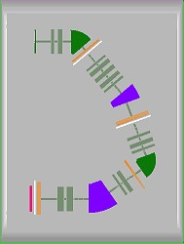
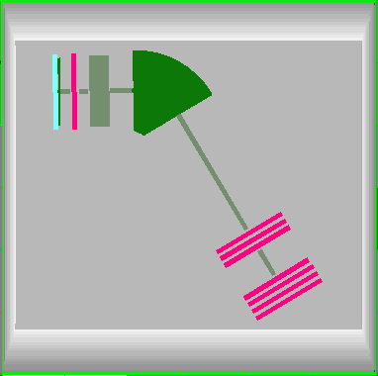
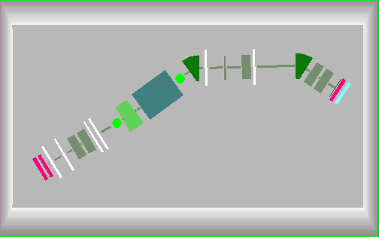
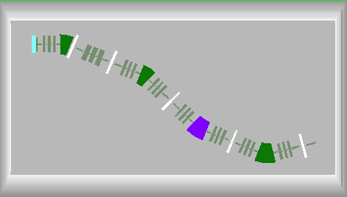
Application : Energy region and Facilities
MARS,
TAMU, USA
SECAR, MSU
DRAGON, Canada
PRISMA, Italy
The LISE⁺⁺ code may be applied at low, medium, and high-energy facilities (fragment- and recoil-separators with electrostatic and/or magnetic selections).
SHELS, Russia
S³, France
BigRIPS+ZeroDegree, Japan
SuperFRS_HEB, Germany

Slide 19
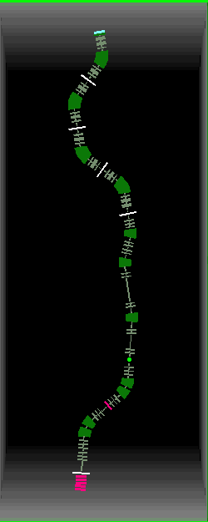
Fragment Separator Construction
with different sections called "blocks" (magnetic and electric multipoles, solenoid, velocity filter, RF deflector and buncher, material in beam, drift, rotation element, and others).
a user-friendly interface that helps to seamlessly construct a fragment separator from the different blocks.
Magnetic dipole (to bend)
Magnetic quadrupole (to focus)
Detector
Slits (to select)
Configuration: A1900_S800BL
(2nd order) 164 blocks

Slide 20
LISE⁺⁺ package
Besides analytical calculation of the transmission and yields of fragments

Slide 21

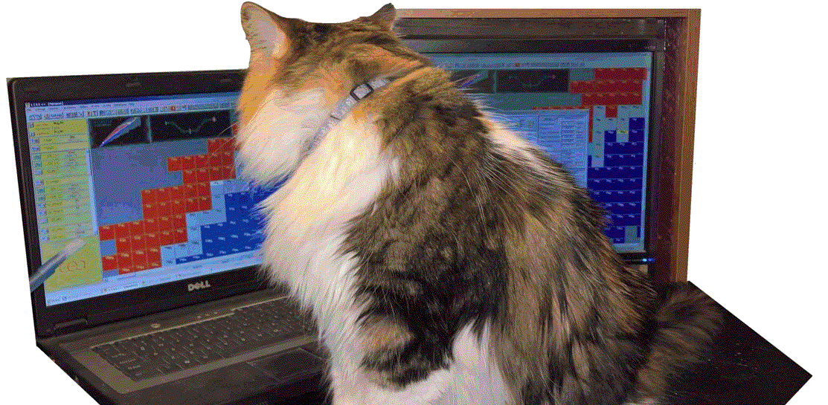
Are you ready?

Slide 22
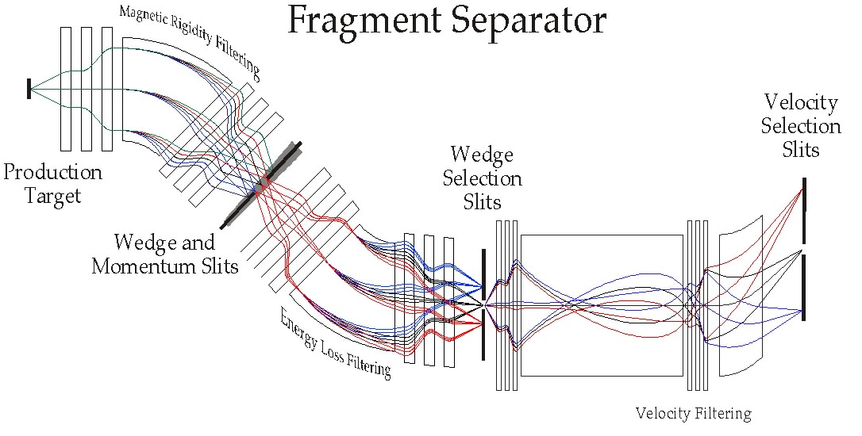

Rare isotope beams: Basic principle of operation
1. Production
3. Registration,
Identification
2. Separation

Slide 23
1
Production

Slide 24
Production
Fragment of interest ⁵⁸Ca
Choice of place for the experiment A1900 @ NSCL default configuration
Settings
  Reaction mechanism Projectile
  fragmentation > 95% experiments @ MSU
  Beam
  Target
  Charge state model no charge states assumed at these energies in this Z-region
  Energy loss model default ATIMA
  Secondary reactions in target no assumed at these energies

Slide 25
Projectile Fragmentation
abrasion
ablation
projectile
target
projectile-like excited fragment
final fragment
Potential beams
⁷⁰Ge (38n+32p)
⁷⁶Ge (44n+32p)
-10p
-10p
-6n
Beam should be a stable isotope
with more neutrons and protons
What is more probable:
To strip 10p and 6n or only 10p?
What factor?
⁵⁸Ca
⁵⁸Ca (38n+20p)
Duke or Kansas? What score?

Slide 26
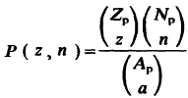
Primary beam choice
What is more probable:
To strip 10p and 6n or only 10p?
What factor?
⁷⁰Ge (38n+32p) → -10p → P = 2.1e-5
⁷⁶Ge (44n+32p) → -10p,-6n → P = 1.3e-2
P(⁷⁶Ge) / P(⁷⁰Ge) = 600 !!!!
http://www.nscl.msu.edu/users/beams.html
What beam from the NSCL list of available beams is more favorable to obtain a ⁵⁸Ca beam?
Conclusion: a primary beam should be more neutron-rich

Slide 27

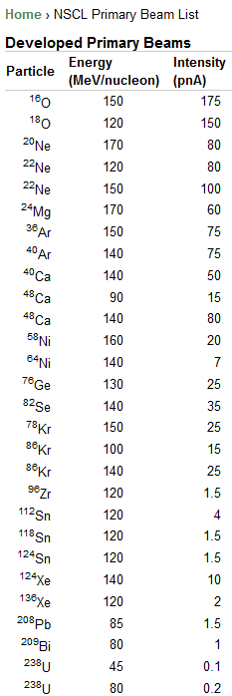
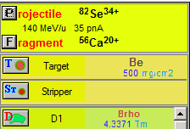
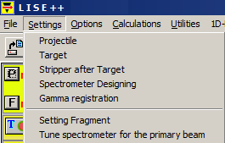
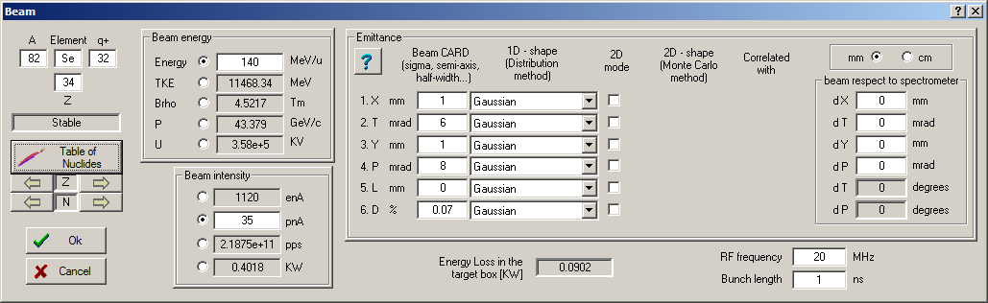
Primary beam settings
What beam from the NSCL list of available beams is more favorable to obtain a ⁵⁸Ca beam?
for all icons in the toolbar and in the production panel
there are corresponding commands in the menu
Answer: ⁸²Se & ⁷⁶Ge are even
We observed 2 events in the
NSCL experiments with a ⁸²Se beam, and with a ⁷⁶Ge beam.
⁸²Se beam is more preferable
to explore nuclei above calcium,
below calcium a ⁷⁶Ge beam.
But, recently the MSU & RIKEN collaboration has observed two ⁶⁰Ca events even with a ⁷⁰Zn beam.
No ⁸²Se and ⁷⁶Ge beams available currently in RIKEN.
So, let’s select a ⁸²Se beam
for our purpose

Slide 28

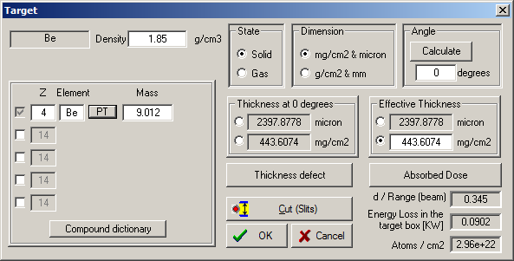
Target settings
Projectile fragmentation case:
    Heavy target : larger cross sections
    Light targets have more nuclei per electron, hence larger nuclear interaction probability at fixed electronic slowing down than heavy target
    Overall case for projectile fragmentation:
    (σ N_{t} ) _{light} > (σ N_{t} ) _{heavy}
    Chemical and physical properties of material
    as melting point, thermal conductivity etc,
    so lifetime of Be target >> lifetime of equivalent Ta target
    Charge state distribution after target:
    light targets provide higher average q of ions
    * using strippers after heavy targets
    Dissipation process larger with heavy targets
    so ⁴⁰Mg and ⁴⁴Si been have observed in ⁴⁸Ca+W
Ratio between target thickness and projectile range (in target)
(range = thickness required to stop a particle)
d/R ~ 0.3-0.35 for maximum fragment yield
Special utility “Optimum target”
    This favors light targets (NSCL uses Be)

Slide 29
1
Selection

Slide 30
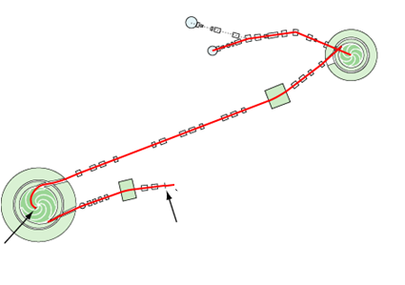
Yield after target
Menu “1D-plot” → “Transmission Characteristics”
ion sources
Example:
⁸²Se→ ⁵⁸Ca
K500
Coupling line
⁸²Se¹³⁺
12.24 MeV/u
K1200
⁸²Se³²⁺
140 MeV/u
0.4 KW
production
target
stripping
foil
How do we select ⁵⁸Ca?

Slide 31
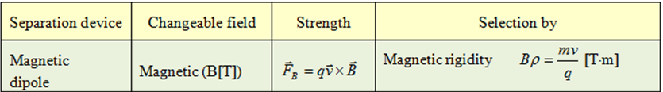
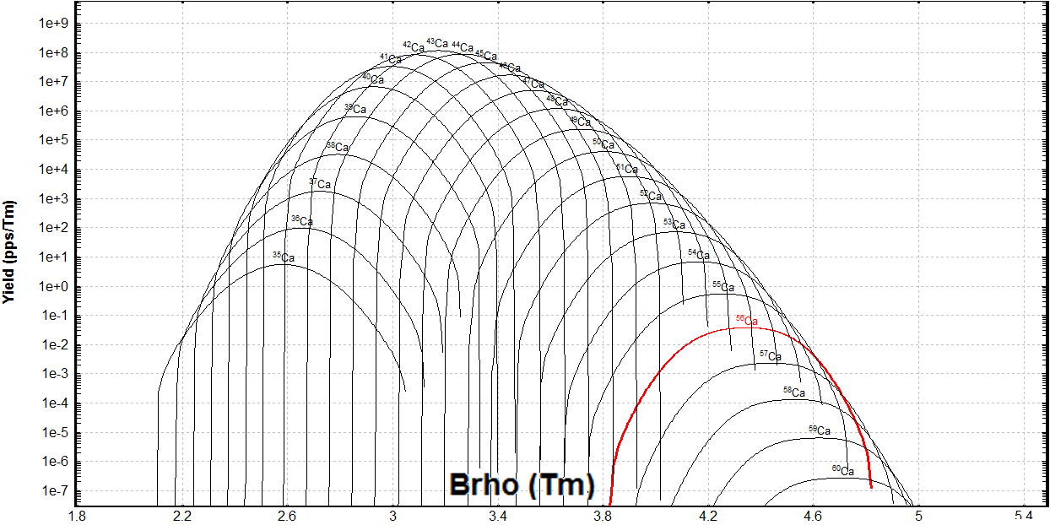
Fragment-separator A1900
magnetic
dipole
max
Changing the I2 slits size,
we change the momentum acceptance
⁸²Se (140 MeV/u) + Be (443mg/cm²) ⇒ **Ca
After target
Settings
on ⁵⁸Ca
Momentum slits

Slide 32
Bρ (magnetic rigidity) selection
Tune separator for setting fragment
After Image2 slits
It corresponds to 2 events/day,
but in reality it will be less (“calcium” anomaly)
Still very high.
DAQ rate should less 1000 cps

Slide 33
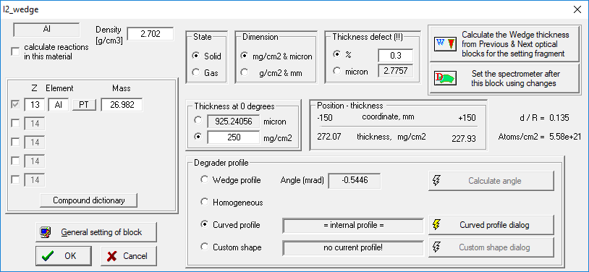
“Wedge” selection (energy loss difference)
www-pdg.lbl.gov
-2.5%
+2.5%
Atomic
number of
fragment
Fragment
velocity
Then higher Z or smaller velocity,
then larger dE/dx (in 10-100 MeV/u energy region)
“Wedge” = wedge-shaped degrader

Slide 34
Wedge selection (energy loss difference)
Tune separator for setting fragment
After Focal Plain slits
Fragment production in wedge
FRIB : the second wedge
separation stage to eliminate
these products

Slide 35
Selection summary
After Target
After Image2 slits
Bρ selection
After Focal Plain slits
“Wedge” selection

Slide 36
1
Identification

Slide 37
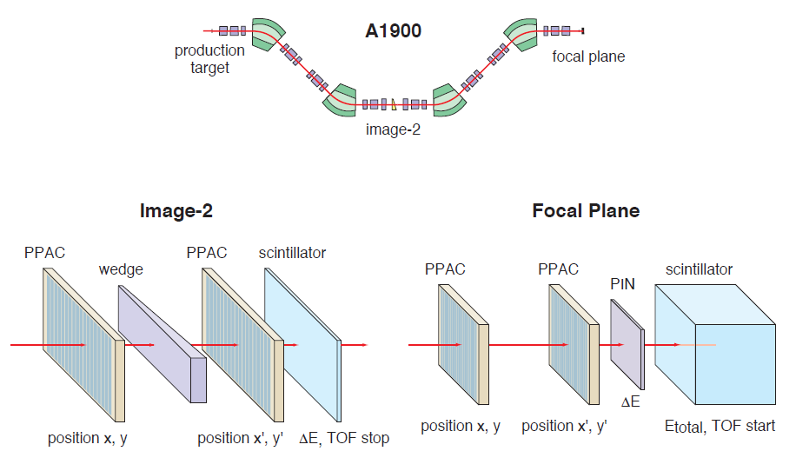
Particle IDentification
What do we want to know?
A
Z
Q
Energy (property of incoming ion in detectors)
What do we measure?
Total kinetic energy
Magnetic (electric) rigidity
Energy loss in detector
Velocity (time of flight)
In our case (low Z, E=140 MeV/u) we assume Q=Z, so we do need only 3 values to measure
Courtesy by A.Stolz
dE
Magnetic rigidity
Time of flight
TKE

Slide 38
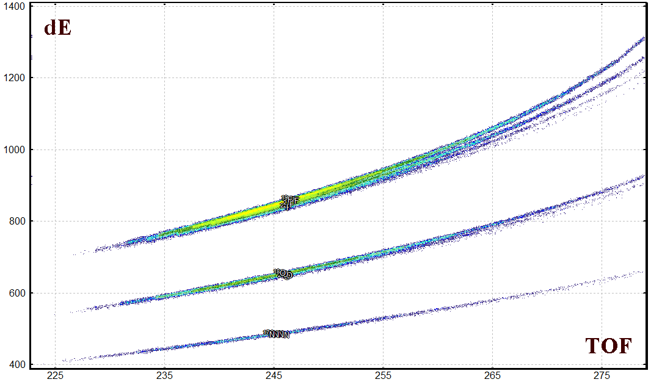
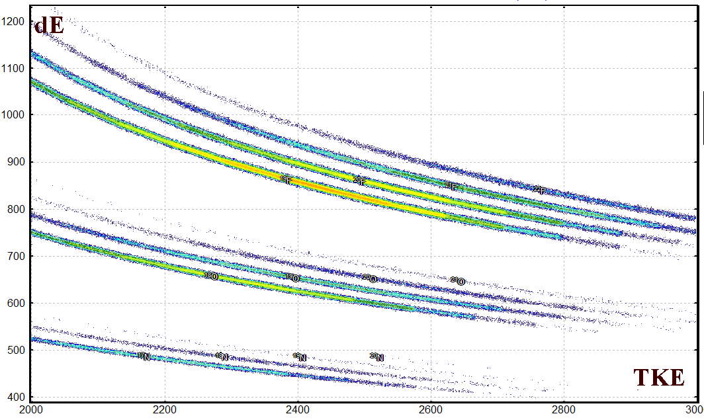
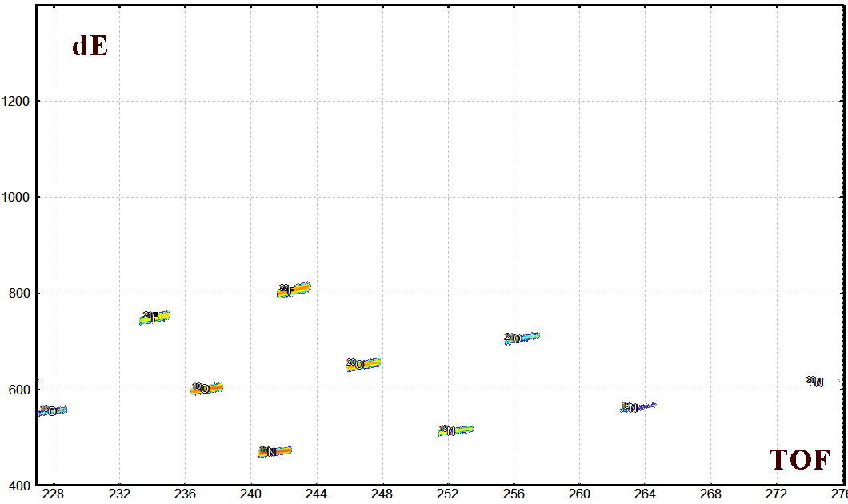
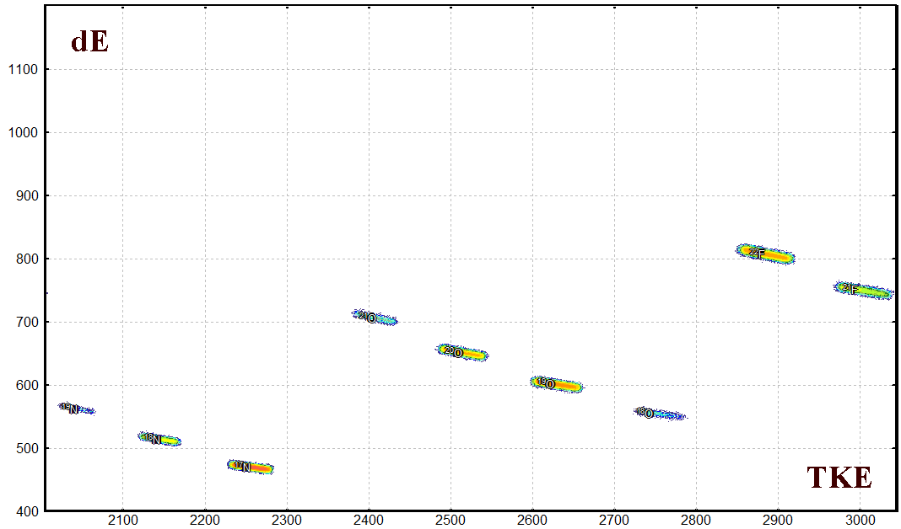
Correlation plots and Bρ-selection
100% momentum acceptance
No isotope separation
²²F
²¹F
²⁰F
²¹O
¹⁹F
F
²⁰O
¹⁹O
¹⁸O
¹⁹N
Ne
¹⁸N
O
¹⁷N
Δp/p=0.6%
Settings on ²⁰O
Good isotope separation
²²F
²²F
²¹F
²¹F
²¹O
²¹O
²⁰O
¹⁹O
²⁰O
¹⁹O
¹⁸O
¹⁹N
¹⁹N
¹⁸O
¹⁸N
¹⁸N
¹⁷N
¹⁷N

Slide 39
Obtaining A, Z, q
The atomic number is determined from the combination of energy loss (ΔЕ) and time of flights (TOF) values according to the Bethe formula:
The fragment mass can be extracted in atomic units from the relativistic formula:
where TKE is calculated as a sum of the energy loss values in each of the detectors in a multilayer telescope stopping the products. The charge state (Q) of the ion evaluated from a relation based on the TKE, velocity and magnetic rigidity values:

Slide 40
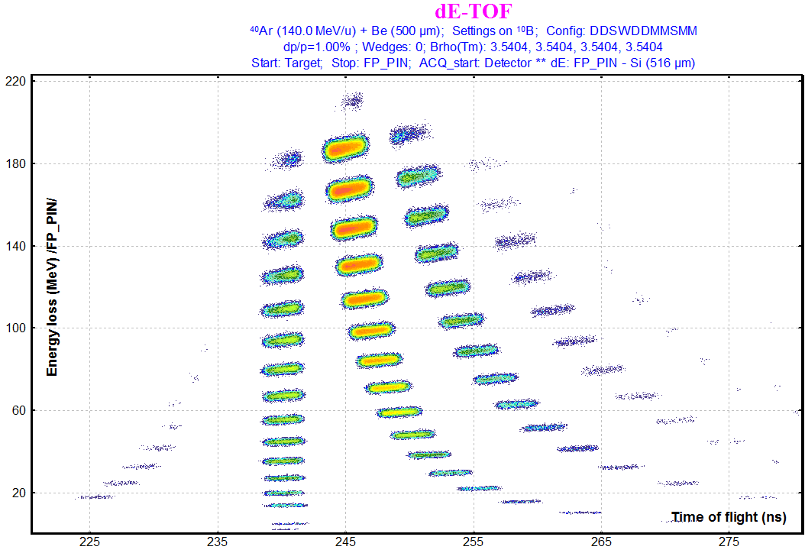
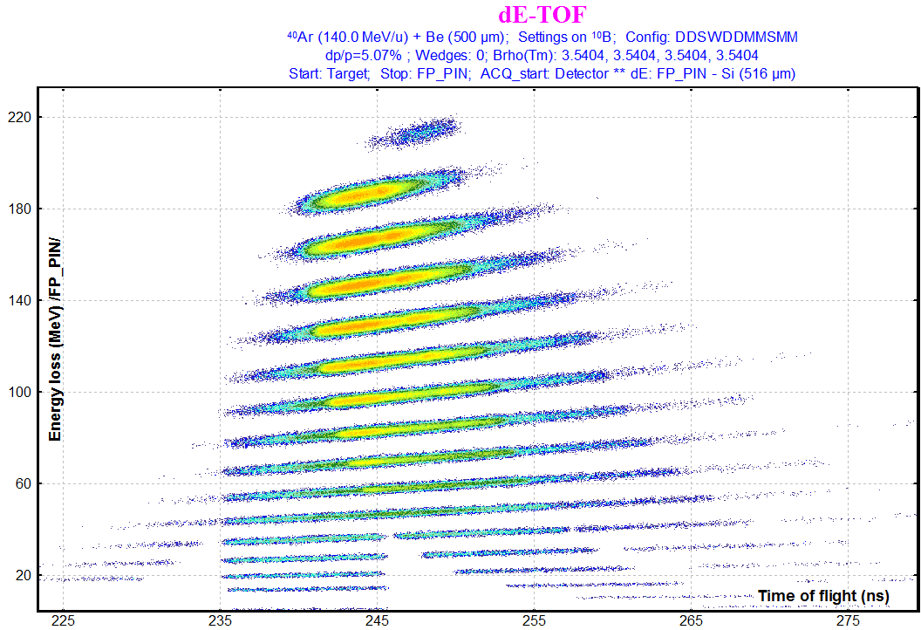
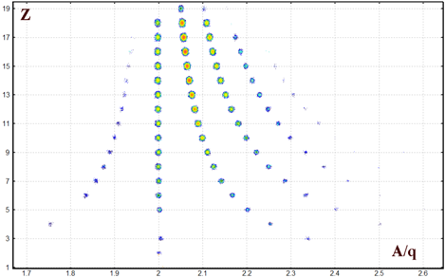
Momentum acceptance
Δp/p=1%
Δp/p=5%
dE
dE
ToF
ToF
Z
Z and A/q resolution will be the same in spite of momentum acceptance value
A/q

Slide 41
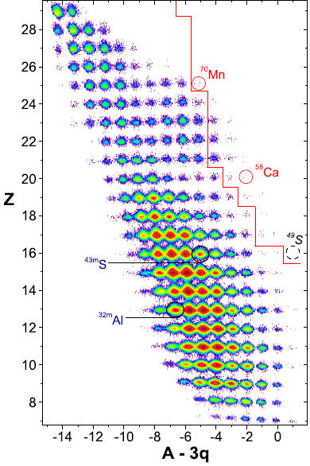
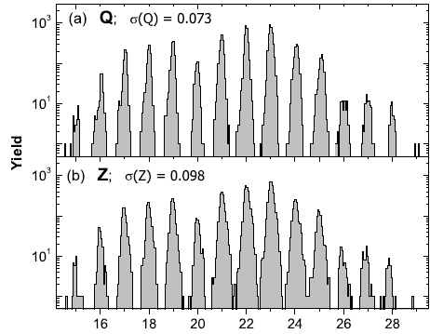
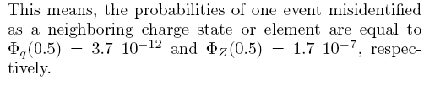
⁷⁶Ge(130MeV/u) + W,Be : PID, resolution
For all particles stopped in the Si-telescope in the production runs
OT et al. Phys.Rev.Lett. 102, 142501 (2009)
OT et al. Phys.Rev.C. 80, 034609 (2009)

Slide 42
Particle identification assignments
Calibration with the primary beam (or other reference line as sources)
Unbound nuclei in the table of nuclides
Stopped fragment tagging with isomeric gamma-rays
In-flight fragment tagging with prompt gamma
X-ray from ions passing material
Laser induced fluorescence
Precise isobar selection with known masses

Slide 43
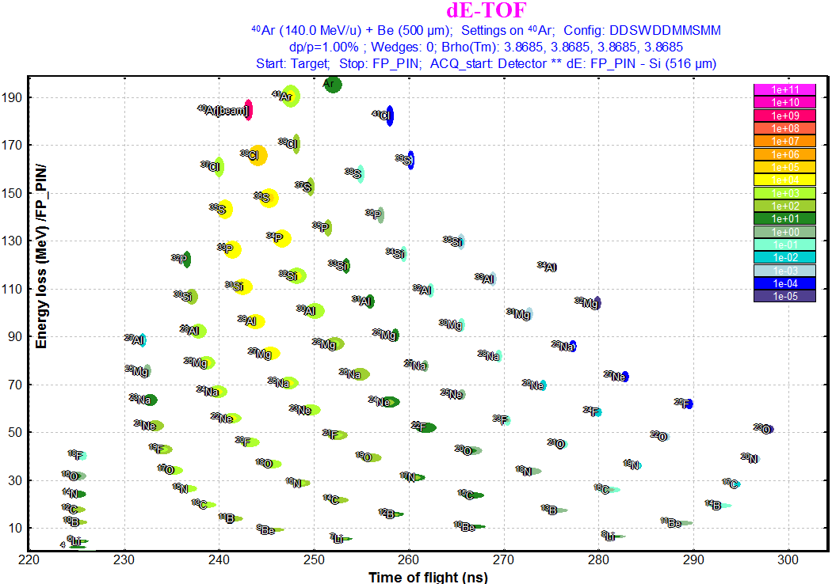

Calibration with the primary beam
Useful then the fragment of interest is close to the projectile

Slide 44


Unbound nuclei in the table of nuclides

Slide 45



Stopped fragment tagging with isomeric gamma-rays

Slide 46


Stopped fragment tagging with isomeric gamma-rays
NSCL #05120
²⁰⁸Pb (86 MeV/u) + Be

Slide 47
Almost finished!
Yes, we did it!
A link on this presentation can be found on the home page of the LISE⁺⁺ site.
There you can also find the “First steps” manual and the detailed course of lectures
"Production of Fast Rare Ion Beams”.

Slide 48





Next Laboratory
Wide Meeting
Questions?
Questions are always good!
⁶²Ca at FRIB.
Where I can find a FRIB fragment separator configuration for LISE⁺⁺ ??
A u planning
a “Rare isotope
rap” sequel?

Slide 49

The
End
“How to Make Rare Isotope Beams at Home”
Theatrical Release poster
Directed by Oleg Tarasov
Produced by NSCL/MSU, NSF
Story by Oleg Tarasov
Brad Sherrill
Written by Oleg Tarasov
Consulted Brad Sherrill
Alexandra Gade
Starring
Brad Sherrill Cat “Varya”
Production Company LISE⁺⁺ pictures studio
Distributed by “FRIB/NSCL Staff Information Talk” group
Release date April 4, 2018 (United States)
Running time 30 minutes
Images from Rare Isotope Rap by “alpinekat” @ youtube https://www.youtube.com/watch?v=677ZmPEFIXE were used

