Slide 1

FRIB logo application based on
Qt Design 3D animation
Sasha Tarasova
Research Assistant
tarasoal@frib.msu.edu
28 March 2024

Slide 2

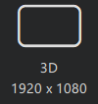

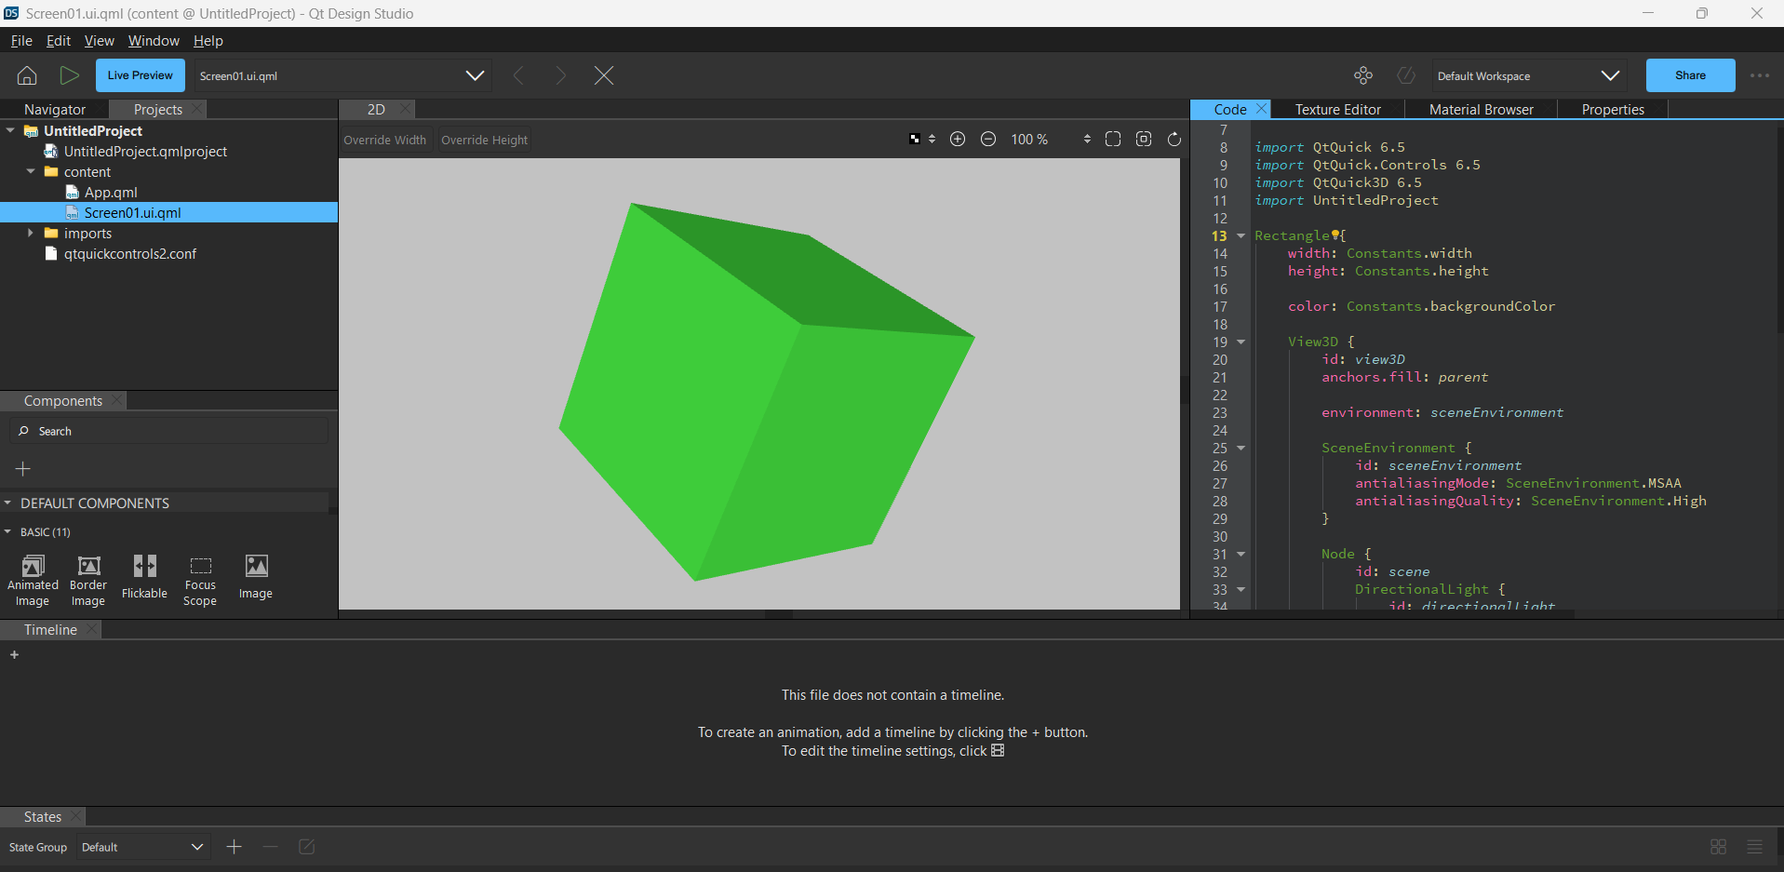
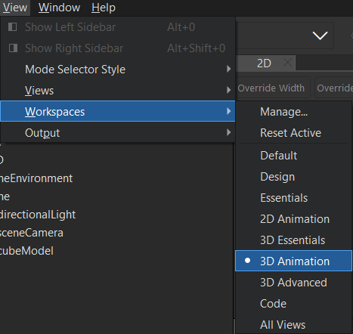
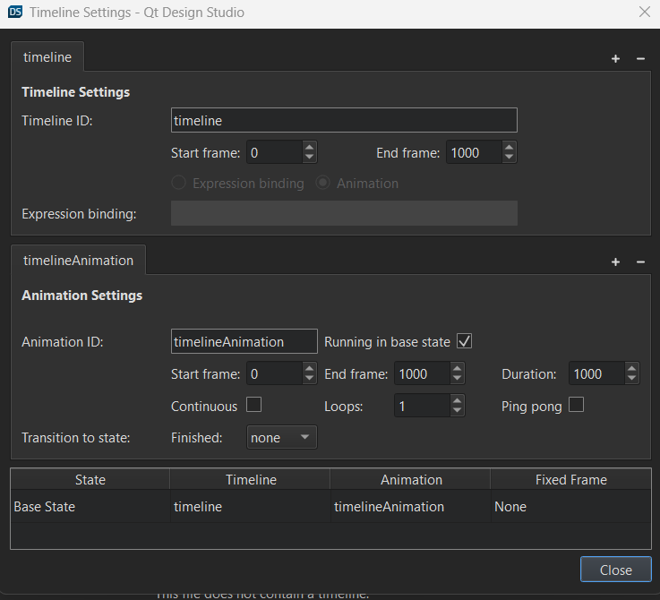
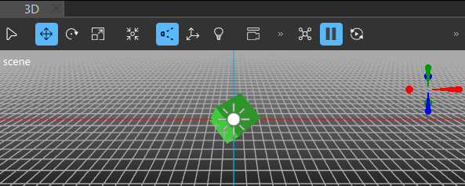

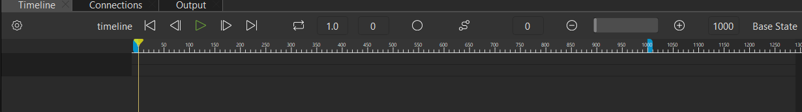
3D Animation Setup
Open QT Design Studio
Select Create Project… 3D
Add 3D space
Add Timeline
View > Workspaces > 3D Animation
Adjust animation frames, duration, and transitions
Drag Primitives into 3D space to manipulate them

Slide 3
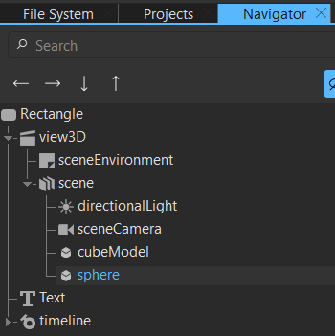
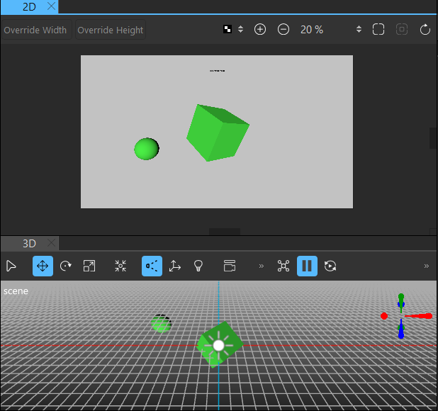
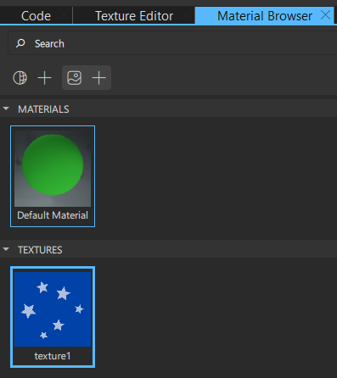

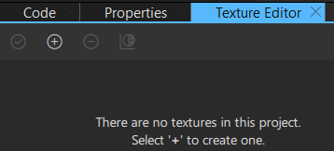
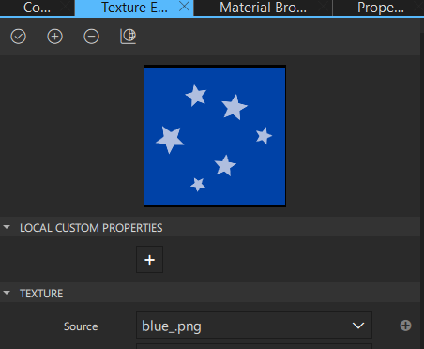
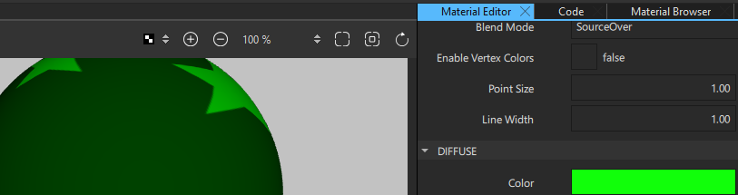
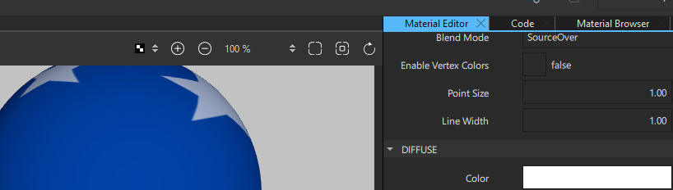
Displaying Images on Objects
1.
Select object of choice from the Navigator and go to the Texture Editor on right-hand side
Drag the texture and drop onto a material
3.
4.
Edit the material by going into
View > Material Editor
Add additional materials and textures
Tip: If you hit Apply on the “Select a material property” pop-up immediately, it goes the texture goes into a “diffuseMap” material. To see the correct color, switch the color to white under Material Editor > Diffuse > Color
Create a new texture and select a file for the source
2.

Slide 4
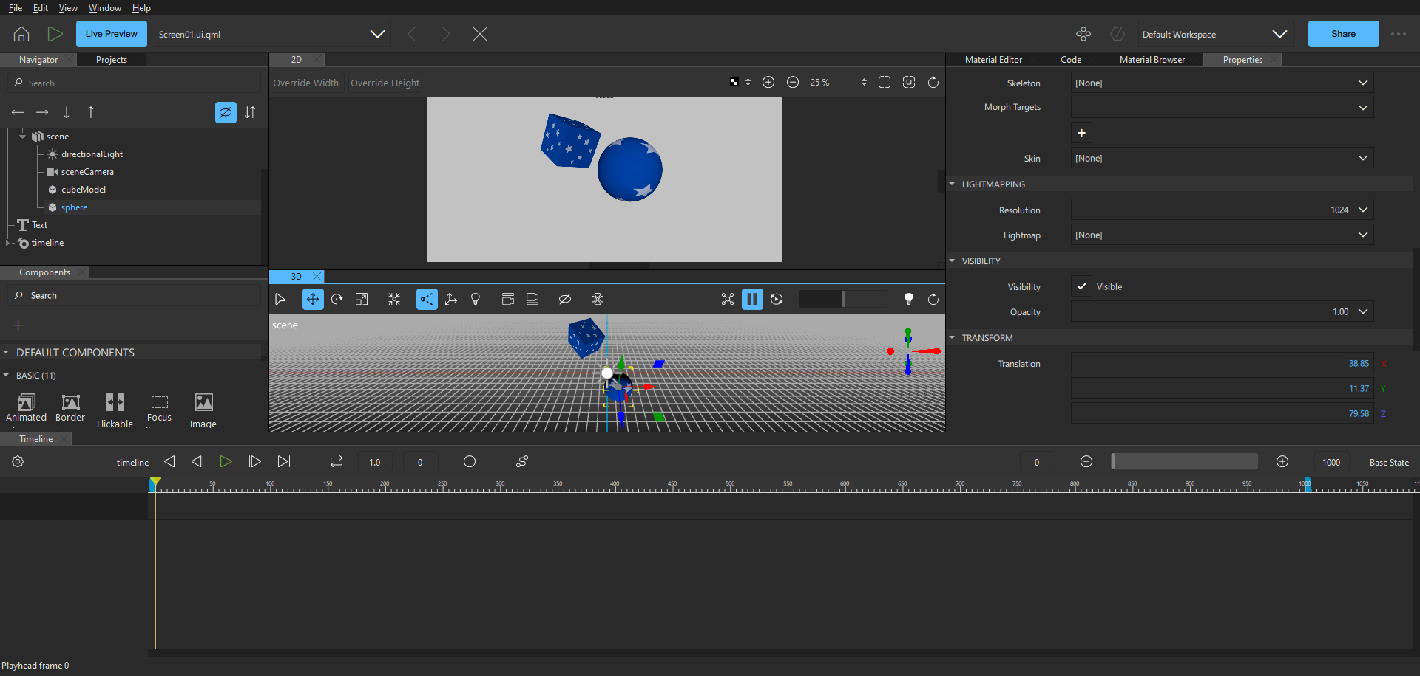
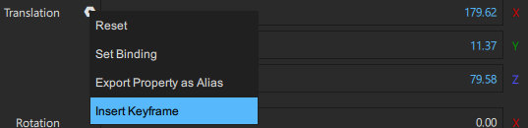
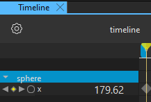
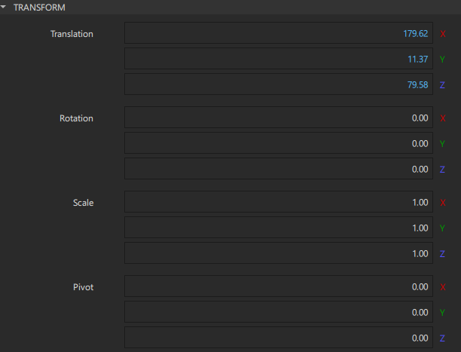
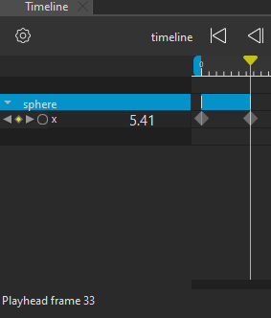
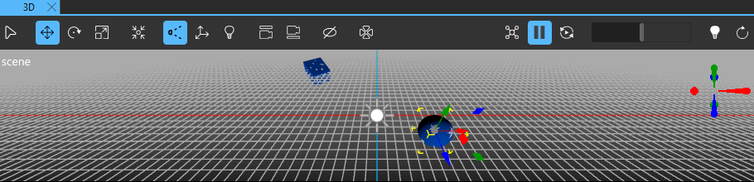

Creating Animation Using a Timeline
1.
Make sure your workspace is set up so you can see the 2D and 3D views, the Timeline, and the Properties Tab
Once you have set your starting position, click on this icon:
and select “Insert Keyframe” to add that property to the timeline
3.
Drag the yellow bar to the frame where you want your next change to happen, change a property, and insert a new keyframe
2.
4.
Transform an object clicking on it in the 3D view and using the tools, or through the Transform tab
5.
Drag the yellow bar across the blue timeline, or hit these buttons:
to see your changes in the 2D View

Slide 5
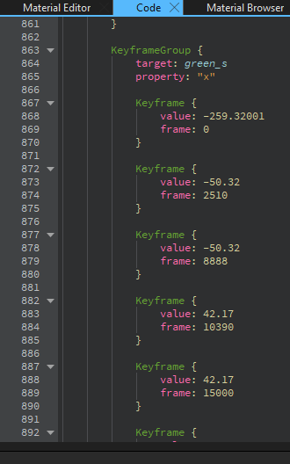
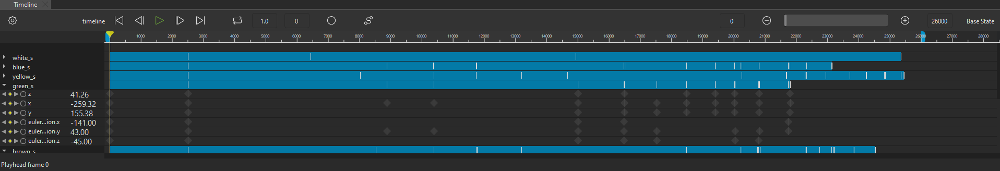
Important
Make sure you save the project often through the File tab, as well as multiple versions, as the program can crash unexpectedly!
To have multiple transformations at once, you need to make sure you insert a keyframe for the start and end of each property change. You can use the Code tab, or drag the yellow bar, to find the specific frame you are looking for

Slide 6
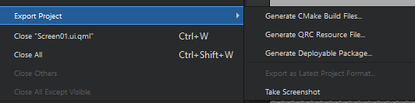
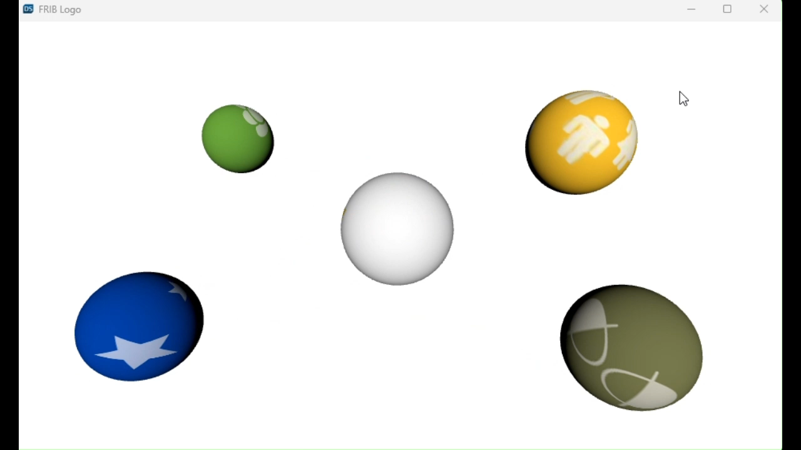

Finishing Up
Once you are happy with your project, make sure to save and export the project to the necessary files with File → Export Project
You can also change the speed with the start and end frames, and whether you want a continuous, or even ping pong reverse animation, through the timeline settings

Slide 7
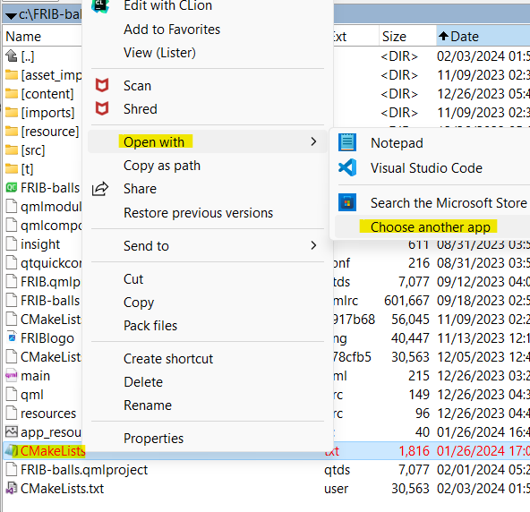
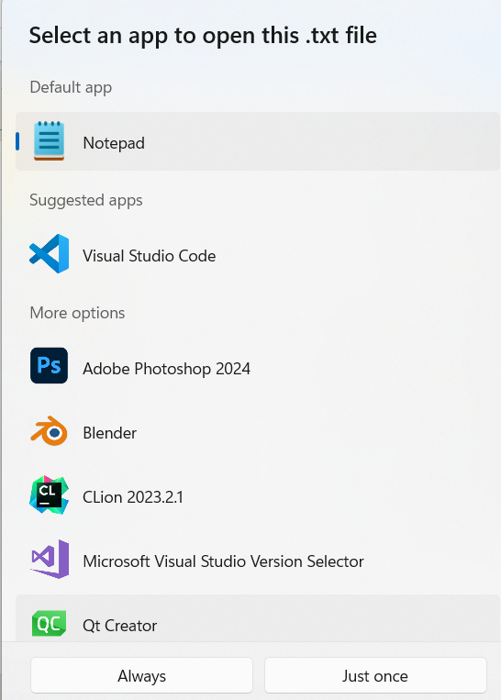

Exporting to Qt Creator
To export to Qt Creator, open the file “CMakeLists.txt” with Qt Creator
To run the animation through Qt Creator, make sure you have all the necessary libraries and resources installed!

Slide 8
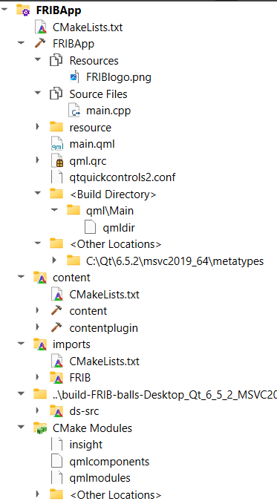
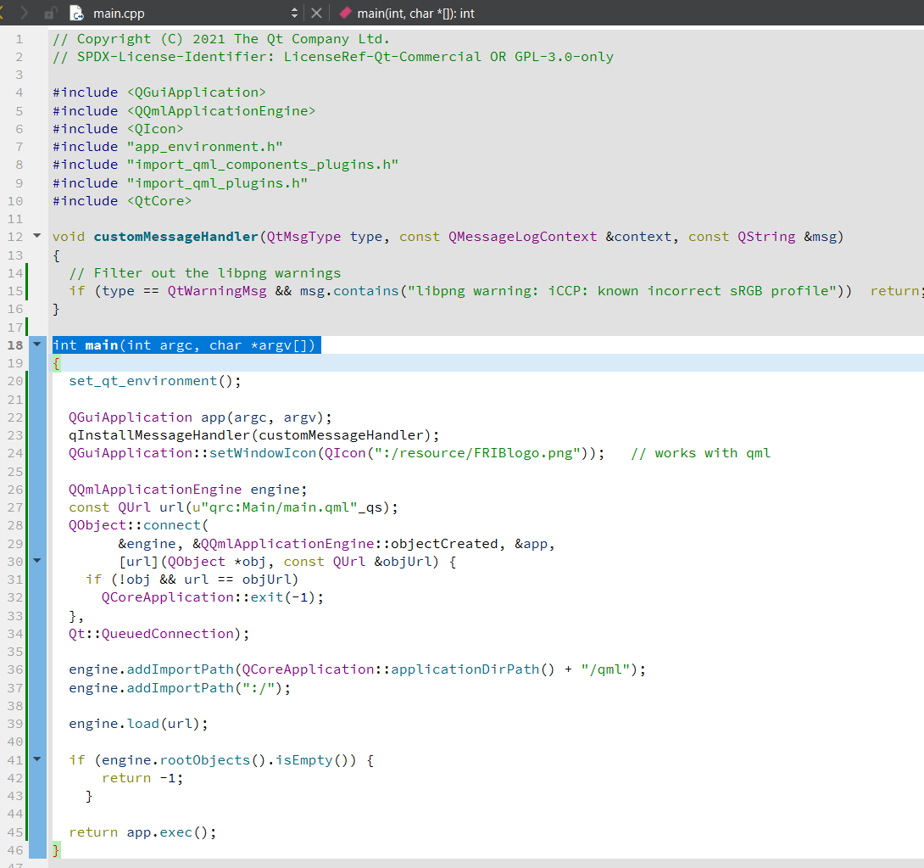
Qt Creator : FRIBapp project

Slide 9
Animated gif after the code video-capture

