Slide 1
Update of Fusion reaction mechanism in LISE⁺⁺
Fission barrier dialog modification
Fusion dialogs
Potential energy
Potential pocket,
L _{critical} , DIC
Fission barrier vanishing,
L _{Bfis=0} , Fast Fission (FA)
Compound Formation,
Quasi-Fission
Barrier penetration,
Quasi-Elastic (QE)
Compound de-excitation :
Fusion – Fission or Residue?
LISE⁺⁺ definitions and features of fusion mechanism
Examples:
²³⁸U (20 MeV/u) + Be, C
⁵⁸Ni + ⁶⁰Ni
³⁶S (12 MeV/u) + ¹²C, ²³⁸U
⁴⁰Ar + ²⁰⁸Pb
v.9.10.60
from 04/09/15
Purpose:
implementation of angular momentum formalism into low-energy reactions
LISE⁺⁺ documentation:
Fusion residue transmission v.5.15
Fusion-Fission v.7.8
Angular momenta vs reaction channels

Slide 2
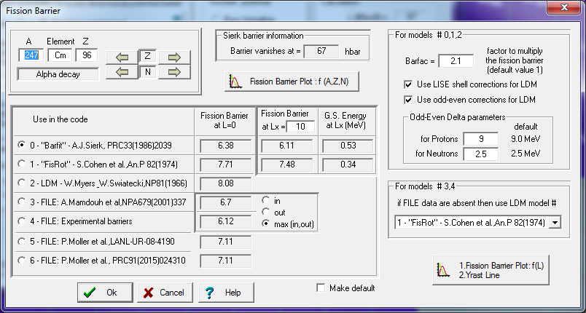
Fission barrier dialog modification
Fission barrier and Yrast line plots as function of L
New Fission barriers from P.Moller et al., PRC91(2015)024310
BarFac parameter for the SHE region
Sierk’s fission barrier validity

Slide 3
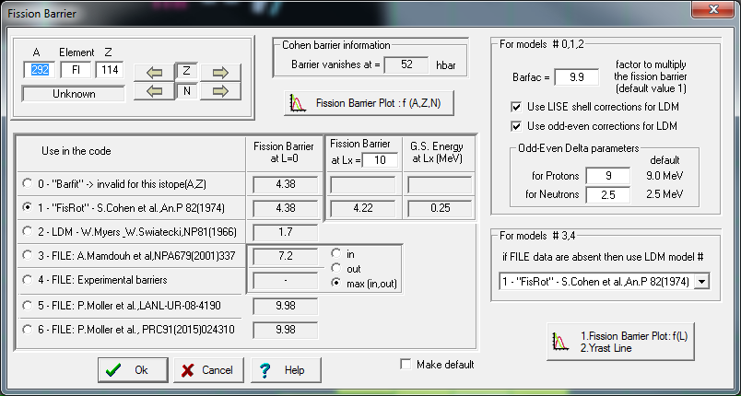
Fission barrier dialog modification
Fission barrier and Yrast line plots as function of L
New Fission barriers from P.Moller et al., PRC91(2015)024310
BarFac parameter for the SHE region
Sierk’s fission barrier validity
It looks like a high Barrier value with AME2012 use.
But LISE⁺⁺ allows to load an user mass excess table

Slide 4
Fission barrier dialog modification
Fission barrier and Yrast line plots as function of L
New Fission barriers from P.Moller et al., PRC91(2015)024310
BarFac parameter for the SHE region
Sierk’s fission barrier validity
Barrier factor to describe experimental data or sophisticated calculations
Fission barrier value plays crucial role between particle evaporation and fission competition in
de-excitation process

Slide 5
Fission barrier dialog modification
Fission barrier and Yrast line plots as function of L
New Fission barriers from P.Moller et al., PRC91(2015)024310
BarFac parameter for the SHE region
Sierk’s fission barrier validity
0. Sierk’s fission barrier is operating up to Z≤110 @ L=0 or Z ≤ 102 @ L>0
1. So, if Sierck’s fission barrier has been selected , and nucleus atomic number is higher 110 at L=0, than Cohen’s barrier will be used.
2. If if Sierck’s fission barrier has been selected , and nucleus atomic number is higher 102 at L>0,
then vanishing factor for Z=102 (with the same N/Z ratio) will be used,
where the Vanishing factor (L) is the ratio of Barrier(A,Z,L) / Barrier(A,Z,0)
Vanishing barrier factor for data from FILEs is based on selection from Sierk or Cohen models in the Fusion dialog

Slide 6

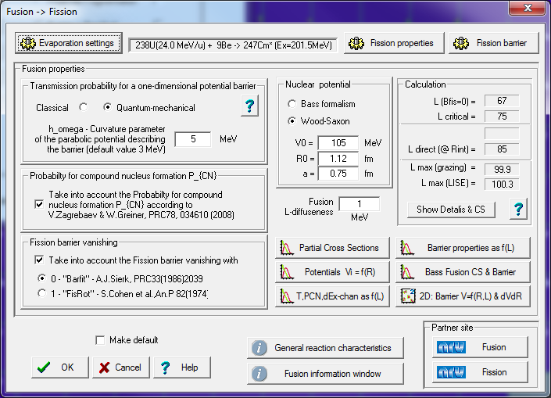
Fusion-Residue and Fusion-Fission dialogs in LISE⁺⁺
Do not hesitate to use Low-Energy reaction computing centers as NRV for more sophisticated solutions with Channel Coupling, Langevin equations and so on

Slide 7
Coming back to the Eighties for definitions

Slide 8
Potential Energy
Default NRV parameters

Slide 9
Critical momentum
Critical momentum : L-value corresponds to potential energy when the pocket is washed out. No fusion
Deep Inelastic
Collision region
L_{critical} ≤ L < L_{direct}
L_{critical}
The potential pocket does not exists,
and the EnergyCM is above the barrier

Slide 10
Deep Inelastic Collision region
Deep Inelastic
Collision region
L_{critical} ≤ L < L_{direct}
The potential pocket does not exists,
and the EnergyCM is above the barrier

Slide 11
Fission Barrier Vanishing as f(L) → Fast Fission (FA)
Fast Fission region
L_{Bfis=0} ≤ L < L_{critical}
The potential pocket still exists,
but no compound formation

Slide 12
Compound formation, Quasi-Fission : ⁴⁸Ca + ²⁰⁸Pb

Slide 13
Compound formation, Quasi-Fission : ⁵⁸Fe + ²⁰⁸Pb

Slide 14
Barrier penetration, Quasi-Elastic (QE) : ²³⁸U(5.4 MeV/u) + C
T_{l} (E) denotes the transmission coefficient of the l-th partial wave through the barrier in the total potential

Slide 15
Barrier penetration, Quasi-Elastic (QE) : ²³⁸U(20.0 MeV/u) + C
T_{l} (E) denotes the transmission coefficient of the l-th partial wave through the barrier in the total potential

Slide 16
Fusion – Fission or Residue?
1st step compound de-excitation plot
fission
evaporation

Slide 17
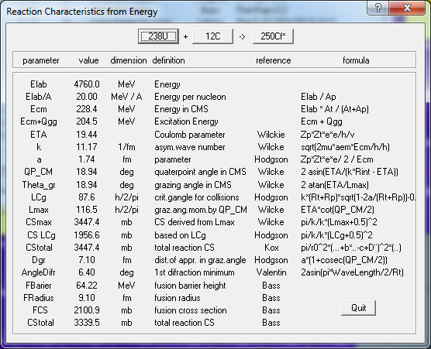
LISE⁺⁺ reaction interpretation from R & L

Slide 18
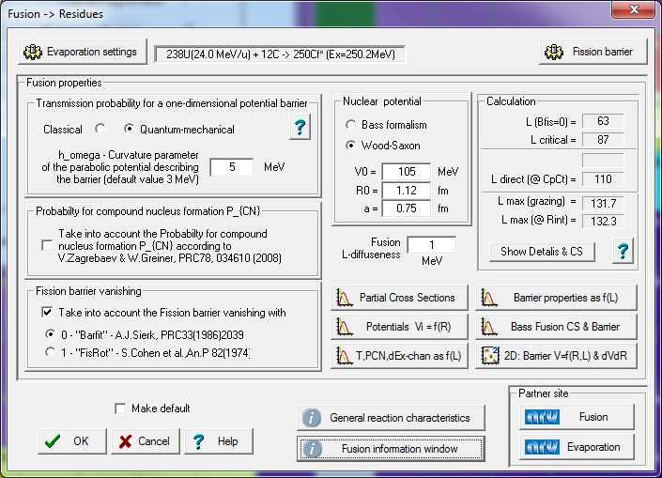
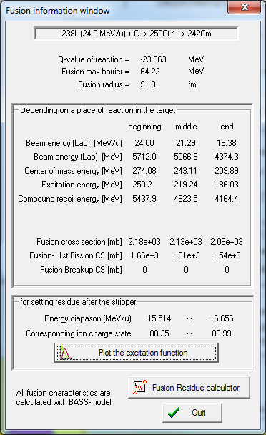
What cross sections will be used in LISE⁺⁺ to get rates?
LISE⁺⁺ still uses
the Bass formalism to calculate fragment rates !!!!
You have to use this calculated factor later to take into account the analysis of partial cross sections

Slide 19
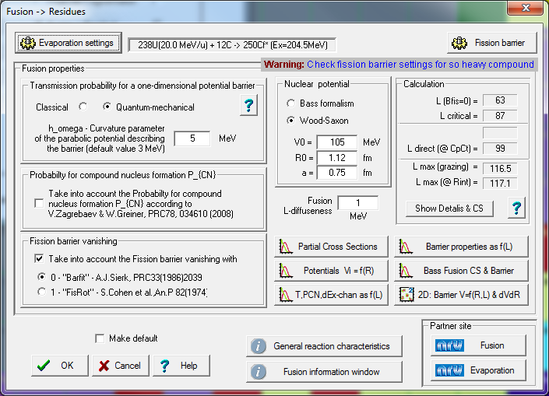
Fusion dialog warning message for barrier settings
Go to the Fission barrier dialog
to modify settings for this SHN region
You will get this message if
The compound Z > 95
In-built fission model
(Barfit, FisRot, or LDM)
was selected
“BarFac” parameter < 1.2

Slide 20
²³⁸U (20.6 MeV/u) with Be vs. C targets
Carbon target.. 50% split… Why?
This is due to difference of moments of inertia between C+U and Be+U just above where fission barrier go to zero

Slide 21
Fission channels for ²³⁸U (20 MeV/u) + Be,C reactions
Compound fission ~100%
Fissile Z = 96
High Excitation Energy
Sequential fission after DIC
Fissile Z < 92
High Excitation Energy
Partially go to fission
Fissile Z~92
Low Excitation Energy

Slide 22
Experimental study of barrier distributions for ⁵⁸Ni+⁶⁰Ni
http://aip2014.org.au/cms/uploads/presentation/elizabeth_williams.pdf
Dr. Elizabeth Williams
Department of Nuclear Physics
The Australian National University, Canberra, ACT, Australia
AIP Congress, Canberra, ACT
9 December 2014

Slide 23
³⁶S (12 MeV/u) + ¹²C, ²³⁸U
¹²C
²³⁸U

Slide 24
⁴⁰Ar + ²⁰⁸Pb

Slide 25
Acknowledgements
I would like to acknowledge to
Profs. D.J.Morrissey, M.Thoennessenn,
Z.Kohley (NSCL/MSU),
Dr.G.Knyazheva (FLNR/Dubna),
for fruitful discussions.

